Slide 1
Probing the Solar Interior on Multiple Timescales Using Global Helioseismololgy
by
Edward Rhodes, University of Southern California and Jet Propulsion Laboratory
Johann Reiter, Technical University Munich
Sasha Kosovichev, Big Bear Solar Observatory, New Jersey Institute of Technology
Jesper Schou, Tim Larson, and Phil Scherrer, Stanford University
Stephen Pinkerton, University of Southern California
HELAS VI/SOHO28/SPACEINN Conference on
Helioseismology and Applications
Max-Planck-Institute fur Sonnensysemforschung
Gottingen, Germany
September 2, 2014

Slide 2
Outline
Description of our methodology
Results of the study of short-term p-mode frequency and width shifts in response to changing levels of solar activity
Results of the study of longer term changes in the solar internal sound speed through inversion of long-duration frequency tables

Slide 3
Methodology
We have studied the temporal variations of the seismic properties of the Sun on both short and long timescales by generating tables of MDI, HMI, and GONG p-mode intermediate- and high-degree frequencies and widths that have come from both short- and long-duration observing time series that were obtained between mid-1996 and mid-2012.
First, we have generated and inter-compared a large number of tables of p-mode properties that have come from observing times series that were three days in duration.
Second, we have generated and inverted a total of 23 p-mode frequency tables of that have been computed from much longer time series of MDI and HMI observations each of which lasted from 1.5 to 3 months.

Slide 4
Summary of MDI Dynamics Run Power Spectral Datasets
MDI was operated in its Dynamics, or Full-Disk, Mode for a total of 15 different Dynamics Runs of varying durations between 1996 and 2010.
We have generated sets of Full-Disk power spectra for degrees up to 1000 that come from the entire duration of all but two of the Dynamics Runs that have high frequency resolution.
We have also divided each of the 15 Dynamics Runs into a series of three-day time intervals and we have generated a set of Full-Disk power spectra from each of these intervals which has much lower frequency resolution.

Slide 5
Summary of HMI Power Spectral Datasets
HMI was initially operated simultaneously with MDI during the 66-day long 2010 Dynamics Run.
Subsequently, the HMI observations have been divided into 21 72-day time series.
Un-averaged, high-degree power spectra have been computed from both the 72-day time series and three-day time series contained within each of the first nine 72-day intervals.

Slide 6
Summary of Available GONG High-Degree Power Spectral Datasets
GONG was upgraded to its current spatial resolution during 2001.
The GONG Project staff computed sets of un-averaged, high-degree power spectra that spanned several different time periods during that year.

Slide 7
Short-Term Study
We have studied the temporal variations of the seismic properties of the Sun on short timescales by studying the response of p-mode frequency and width changes to corresponding changes in the level of solar activity.
We have done so by generating a large number of frequency and width tables each of which has come from observational time series that were three days in duration.

Slide 8
Sort-term Variations in MDI, HMI, and GONG Intermediate- and High-Degree Frequencies and Widths
I will now highlight recent results derived from the fitting of m-averaged spectra. The results I will present were derived by regressing sets of binned differences in the fitted frequencies and widths upon differences in ten different solar activity indicators. These linear regression analyses were carried out for 25 different frequency bins for each of the datasets

Slide 9
Linear Regression Analyses of Binned Frequency Shifts Versus Changes in Magnetic
Plage Strength Index, MPSI, at a Frequency Where Both Sets of Changes Were Correlated
MDI,
1996
GONG,
Fall-2001

Slide 10
Linear Regression Analyses of Binned Frequency Shifts Versus Changes in Magnetic Plage Strength Index, MPSI, at a Higher Frequency Where Both Sets of Changes Were Anti-Correlated
MDI,
1996
GONG,
Fall-2001

Slide 11
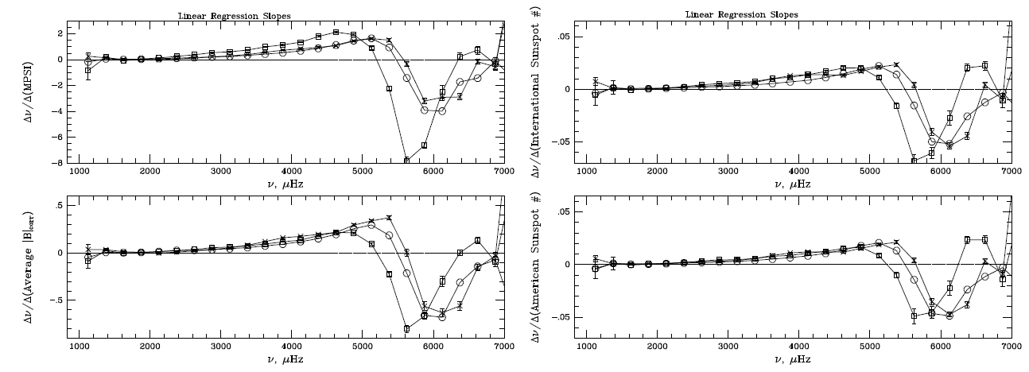
Our Study of p-mode Frequency Shifts During Cycle 23 Shows a Continuous
Variation in the Sensitivity of These Frequency Shifts To Changes In Solar Activity As a
Function of Frequency. We have also Shown that the Frequencies Where the Frequency Shifts Change From Being Correlated With Activity Changes to Being Anti-Correlated Change with the Mean Level of Activity as shown below:
1996
Spring-2001
Fall-2001
1996
Spring-2001
Fall-2001

Slide 12
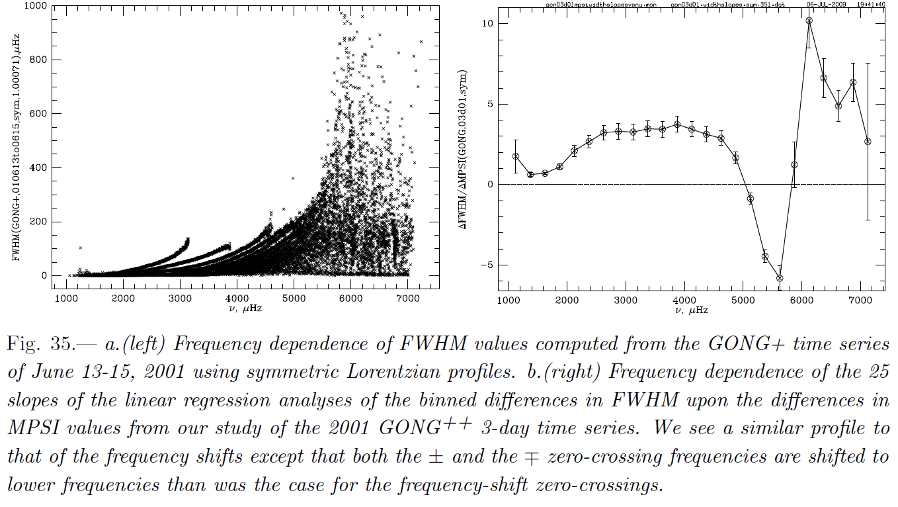
P-mode Linewidths Also Show a Similar, but Slightly Different Dependence Upon Solar
Activity Changes as Shown Using GONG+ Data From Fall-2001

Slide 13
Comparison of Regression Slopes from Frequency and Width Shift Studies
Frequency shift
regression slopes
Width shift
Regression slopes
Both +/- and -/+ Zero-Crossing Frequencies Are Lower for Width Shifts

Slide 14
Solar Cycle Dependence of Frequency and Width Zero-crossings
By repeating the above short-term analyses for every annual MDI Dynamics Run and for the first nine HMI 72-day observing intervals, we have been able to show that the “+/-” and “-/+” zero-crossing frequencies for both the frequencies and line widths vary systematically with the changing mean level of activity during each analysis interval.

Slide 15
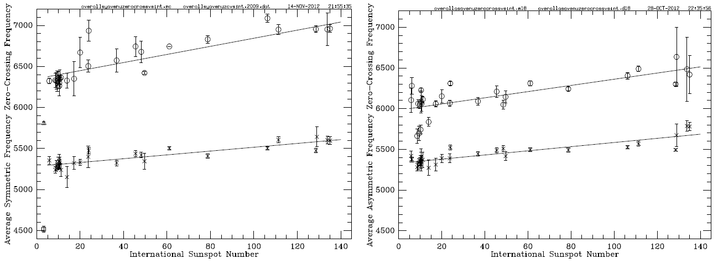
Both our +/- (lower set) and -/+ (upper set) Zero-Crossing Frequencies That Came from the
Temporal Shifts Of MDI, GONG+, and HMI p-Mode Frequencies Clearly Depend Upon the
Mean Level Of Activity During Each of Our Time Intervals Regardless Of Our Use of
Symmetric (Left) or Asymmetric (right) Profiles. These zero-crossing trends are likely Due
To Solar Cycle Dependent Changes in the Acoustic Cutoff Frequency, Which Are Likely
Caused Themselves By the Changing level of Magnetic Fields in the Solar Interior

Slide 16
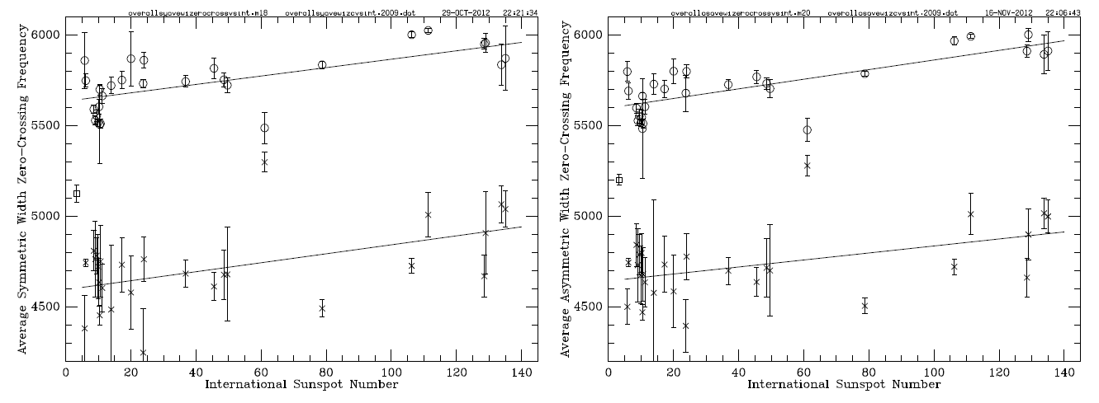
Both our +/- (lower set) and -/+ (upper set) Zero-Crossing Frequencies That Came from the
Temporal Shifts Of MDI, GONG+, and HMI p-Mode Linewidths Clearly Depend Upon the
Mean Level Of Activity During Each of Our Time Intervals Regardless Of Our Use of
Symmetric (Left) or Asymmetric (right) Profiles. The Linewidth Zero-crossings Occur at Lower
Frequencies Than Do the Frequency Zero-Crossings.

Slide 17
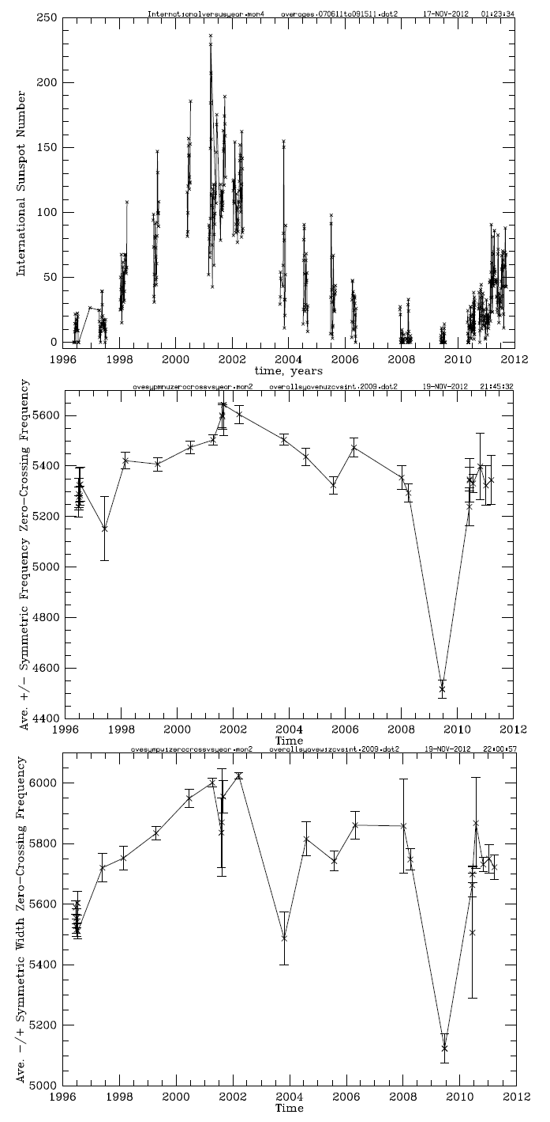
Our Measured 2009 Solar Minimum
Zero-Crossing Frequencies for the
Changes in both the p-Mode Frequencies
and in the p-Mode Widths
Were Substantially Below
All Previous and Subsequent
Zero-Crossings

Slide 18
Our +/- zero-crossing frequencies are systematically higher than the so-called acoustic
cutoff frequencies of Jimenez, Garcia, and Palle (2011), but both quantities show a
similar solar cycle dependence during Cycle 23

Slide 19
Both our “+/-” zero-crossing frequencies and the “acoustic cutoff frequencies” of Jimenez,
Garcia and Palle (2011) are correlated with each other although the zero-crossing
Frequencies show a wider range of variations than do their measurements

Slide 20
Summary of Short-Term Frequency and Width Shift Discoveries
We have shown that the temporal p-mode frequency shifts have a systematic dependence upon the frequencies of the modes in which the shifts are correlated with changes in activity at the lower frequencies, but then become anti-correlated with the activity changes at higher frequencies, and may also return to being correlated with the activity changes at the highest frequencies

Slide 21
Summary of Short-Term Frequency and Width Shift Discoveries (cont.)
We have shown that the slopes of the width shifts change sign at different frequencies than do the slopes of the frequency shifts themselves.
We have shown that the frequencies where both the frequency shifts and the width shifts change sign (i.e., the so-called +/- and -/+ zero-crossing frequencies) also change with the changing level of overall level of solar activity from year to year.
We have shown that the zero-crossing frequencies are closer to the theoretical acoustic cutoff frequencies than are those of Jimenez, Garcia, and Palle.

Slide 22
Search for Temporal Changes in the Internal Solar Sound Speed
We have now generated sets of 45- to 94-day power spectra which came from all but two of the 15 of the annual MDI Dynamics Runs between 1996 through 2010, and we have also generated power spectra that were computed from nine HMI 72-day observing runs from mid-2010 through mid-2012.
We have employed our WMLTP method to fit each of these sets of m-averaged spectra.
We have identified a common set of roughly 6300 modes having frequencies between 900 and 4500 μHz that were present in all 23 frequency tables.

Slide 23
Complete Set of 12359 Intermediate- and High-Degree Frequencies Computed by Johann
Reiter Using Latest Version of WMLTP Fitting Code on m-Averaged Spectra from 2010 MDI
Dynamics Run. Subset of 6366 Frequencies of Degrees Up To 1000 That Ranged Between 0.9 and 4.5 mHz That Was Recently Inverted by Sasha Kosovichev Is Shown in Red

Slide 24
New Structural inversions of Both MDI and HMI Full-disk Frequency Tables
We carried out identical structural inversions for all 23 high-resolution frequency tables using the common mode set.
Most of the 23 input tables were inverted “as-is,” but after several of the inverted sound speed profiles showed non-solar oscillations in the radial profile of the sound speed in the deep interior, we cleaned five of the tables and repeated those inversions.

Slide 25
MDI Full-Disk m-Averaged Common Mode Set Inversion Results

Slide 26
HMI Full-Disk m-Averaged Common Mode Set Inversion Results

Slide 27
The Solar Subsurface Shear Layer
The solar subsurface, or near surface, shear layer was first identified by our group using observations of p-mode rotational frequency-splitting coefficients that were obtained at the Mount Wilson 60-Foot Solar Tower in 1994 by Steve Tomczyk.
Later Sylvain Korzennik acquired higher resolution observations at the 60-Foot Tower in 1988 and extended the observations of the shear layer closer to the solar surface.

Slide 28
Radial Profile of Equatorial Angular Velocity Computed From An Inversion of Frequency-splitting Coefficients Computed By Jesper Schou of MDI Data Acquired During the 1996 Solar Minimum Which Shows the Solar Subsurface Shear Layer at the Right
ΔR= R_{sun} -R_{base}
ΔΩ=Ω_{max}−Ω_{surf}
R_{base}/R_{sun}=0.94

Slide 29
MDI Full-Disk Convection Zone and Subsurface Shear Layer

Slide 30
HMI Full-Disk Convection Zone and Subsurface Shear Layer

Slide 31
We also studied the
dependence of the squared
sound speed deviations
from Model S upon the
mean level of solar
activity during each
of the 23 observing
intervals. It is important to
note that all three of the
points that lie well above
the linear regression fit
came from inversions of
un-cleaned data sets. It is
also important to note that
the 2009 inversion showed
the only positive deviations
that we have ever seen.

Slide 32
Inverted Internal Sound Speeds
Because of the strong radial decrease in the
internal sound speed, the use of the squared
deviations from Model S tends to overstate
the magnitude of the sound speed changes
at the outer mesh points. Therefore, we have
interpolated the internal sound speed from
Model S at each of the radial mesh points of our
inversions and we have then used those
interpolated values to convert the squared
sound speed deviations directly into inverted
sound speeds at each of those mesh points
for each of the 23 observing intervals. One such
example is shown at the right. At the scale of
this plot, the profile of the inverted sound
speed is indistinguishable from that in Model S.

Slide 33
Outer Profiles of MDI Sound Speed Deviations from Model S

Slide 34
Outer Profiles of HMI Sound Speed Deviations from Model S

Slide 35
Outlier Correction Procedure
Our initial attempt at performing a solar structural inversion on the table of fitted frequencies from the 2010 MDI spectra resulted in an unphysical oscillation in the radial sound speed profile in the radiative zone.
Because of this problem, we have developed a procedure to identify outlying frequencies and to replace them with re-fitted frequencies and with larger frequency uncertainties where necessary.
I will now describe the first of the steps in this process before I will compare several of our inversion results from the cleaned tables with those from the raw tables.

Slide 37
Comparison of Inverted Squared Sound Speed Deviations from both Original (red) and cleaned (blue) Frequency Tables for One MDI Run

Slide 38
Comparison of raw and cleaned squared sound speed deviations for Second MDI Run

Slide 39
Comparison of Raw and Cleaned Profiles from A Third MDI Run

Slide 40
Comparison of HMI Raw and Cleaned Full-Disk Inversion Profiles from one Run

Slide 41
Demonstration that use of Non-n-Averaged Frequency Splitting Coefficients (red curve) Results in Even Larger Deviations from Model S than When n-averaged Coefficients Are Used

Slide 42
Comparison of 5 Simultaneous MDI and HMI Medium-l Inversion Profiles

Slide 43
Overall Conclusions
Helioseismology has matured to the point where studies of solar cycle dependent changes in solar internal structure are now possible.
We have found very interesting departures from the standard solar thermodynamic structure in the outer half of the convection zone and in the subsurface shear layer shortly after the Cycle 23-24 Minimum.

Slide 44
Thank You for Your Attention!

Slide 45
Recent MDI and HMI Medium-l Sound Speed Inversions

Slide 46
MDI Medium-l Variable Mode Sets

Slide 47
HMI Medium-l Variable Mode Sets

Slide 48
MDI Medium-l Common Mode Set

Slide 49
HMI Medium-l Common Mode Set

Slide 50
MDI Medium-l Common Mode Set Equal Errors for All Sets

Slide 51
HMI Medium-l Common Mode Set Equal Errors for All Sets

