Slide 1
Distortion of global mode eigenfunctions - Measuring meridional flow and solar rotation
Ariane Schad^{1,2}, Jens Timmer², Markus Roth¹
¹Kiepenheuer-Institut für Sonnenphysik
²Freiburg Center for Data Analysis and Modeling, University of Freiburg
HELAS VI / SOHO-28 / SpaceInn
04 September 2014
Göttingen, Germany

Slide 2
Perturbation & coupling of p-modes
> flows lead to a coupling of modes in a „neighborhood“ K_{k} of a mode k=(n,l,m):
> c_{kk‘} – coupling coefficient between mode k,k‘ (≈coupling strength):
(Lavely & Ritzwoller 1992)
perturbed eigenfunction
unperturbed eigenfunction
(1. order approximation)
advection of acoustic wave
(Schad et al., ApJ, 2011)

Slide 3
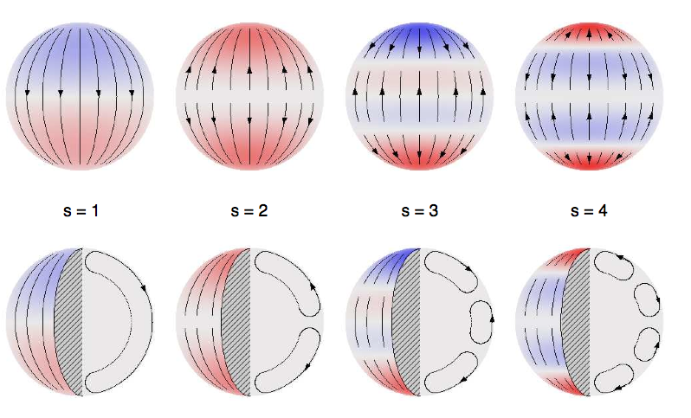
Perturbation & coupling of p-modes due to meridional flow
Spherical harmonic representation of u:
conservation of mass:
Polynomial expansion of coupling coefficients:
b-coefficients:
> knowing {b^{s}_{k‘k}} one can infer the flow coefficients u_{s}(r) & v_{s}(r)!
radial component
horizontal component
s=1 s=2 s=3 s=4
( Figure source: D. Hathaway, NASA)
(Schad et al., ApJ, 2011)

Slide 4
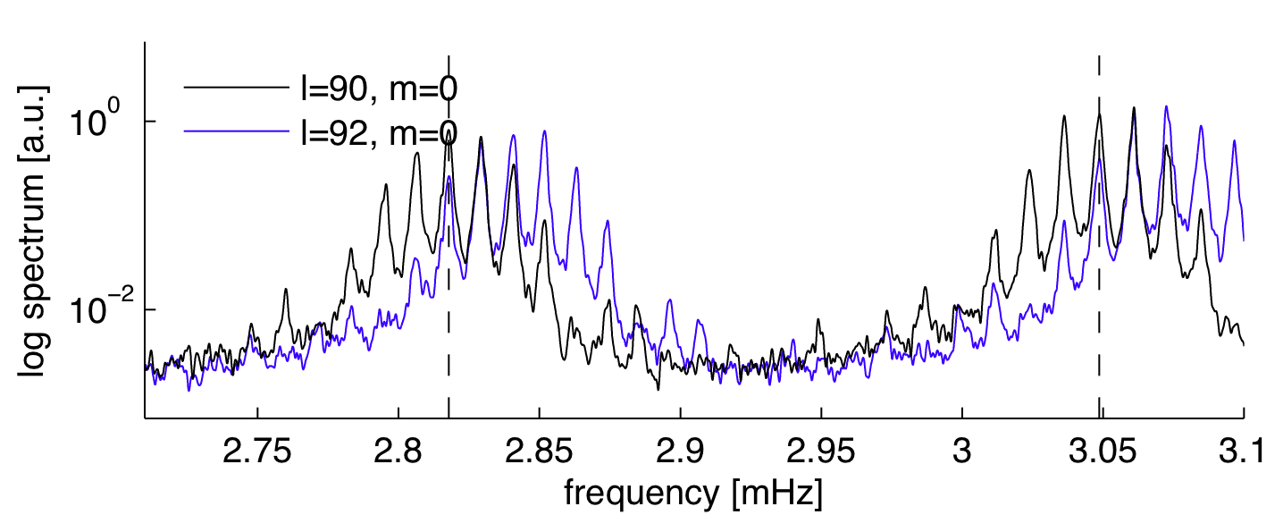
Effect of mode coupling on global oscillation data
SHT of full-disk Dopplergrams:
L_{k‘k‘‘} - leakage matrix elements (imperfect orthogonality: line of sight projection, solar disk, etc.)
M
Measure for cross-talk in SHT data: (Fourier) amplitude ratio: between reference mode k=(n,l,m) and coupling modes k‘
(Schad et al., ApJ, 2011)
(Schad et al., ApJL, 2013)

Slide 5
Application to MDI data - superimposed flow components (s =2,4,6,8)
> MDI data 2004-2010, 1 ≤ l ≤ 200, s=1,...,8
> complex flow pattern in latitude & depth
> in contrast to „prevalent“ picture of two flow cells
outward
northward
inward
southward
(Schad et al., ApJL 2013)

Slide 6
Evaluation of the method
How can we evaluate the method and the reliability of the result?
> analysis of simulated acoustic wave fields
> comparison of flow measurements from different methods: here for rotation!

Slide 7
Evaluation: Analysis of simulated acoustic wavefield
simulated flow
3D simulation of acoustic wavefield (T. Hartlep et al. 2013)
meridional flow (500 m/s)
- T ≈ 2.7d
- dt = 30s
- l = 1,...,170
without leakage

Slide 8
Evaluation: Analysis of simulated acoustic wavefield - results
simulated flow
inversion result
3D simulation of acoustic wavefield (T. Hartlep et al. 2013)
meridional flow (500 m/s)
- T ≈ 2.7d
- dt = 30s
- l = 1,...,170
without leakage
> s = 2,...,8
> inversion results resembles flow model
> deviations near surface & base of CZ
(l<=170, short T)

Slide 9
Evaluation: Mode coupling due to rotation - extension
Toroidal velocity field of solar rotation:
s = num. of zonal bands in latitude
Extension of coupling coefficient:
Expansion coefficients:
(Ritzwoller & Lavely 1991)
(Schad, Dissertation 2013, Vorontsov MNRAS 2011)

Slide 10
Influence of rotation on amplitude ratios
Amplitude ratios from MDI data vs. flow model (coupling modes: n=1, l=180 and n‘=1, l‘=182):
> azimuthal asymmetry
> can be explained by the influence of rotation
> symmetrization of a-ratios in „m“ can compensate for rotation effect
real part imaginary part
(Schad, Dissertation 2013)

Slide 11
Inversion for rotation – first results
> Rotationrate profile from splitting - coefficients (J. Schou)
MDI data (2004-2010)
1 ≤ l ≤ 200
superimpose components with s>1 : cross-coupling, i.e., a-coefficients not sensitive to s=1 (i.e., „mean“ rotation rate)
splitting coeff. : w₁-w₉
splitting coeff.: w₃-w₉

Slide 12
Inversion for rotation – first results
splitting coeff. : w₁-w₉
splitting coeff.: w₃-w₉
eigenfunctions: w₃-w₉

Slide 13
Inversion for rotation – first results
splitting coeff. : w₁-w₉
splitting coeff.: w₃-w₉
eigenfunctions: w₃-w₉
> similar rotation profiles, but significant differences
> larger errors from eigenfunction perturbation analysis

Slide 14
Summary
> analysis of simulated data – resembles flow, differences must be cleared
> rotation profiles are similar, but there are significant differences
> origin so far unclear: - leakage matrix
- numerical: SOLA inversion
- parameter estimation – nonlinear model > bias?
- theoretical eigenfunctions of p modes - how good are they, esp. near the surface ?
> disentangle numerical from solar issues
> test different leakage matrices
> compare different inversion methods (SOLA, RLS,...)
> analyze further data (simulated, HMI)

Slide 15
Thank you for your attention!
Thanks to
Markus Roth, Kiepenheuer-Institut für Sonnenphysik, Freiburg
Jens Timmer, University of Freiburg, Freiburg Center for Data analysis and modeling
MDI data & leakage matrix
Jesper Schou, MDI & HMI team, MPS Göttingen
Tim Larson, MDI & HMI team, Stanford University

Slide 18
Inversion for rotation: comparison of results
> Results for s=2,...,9:
splitting coeff. (black)
eigenfun. perturbation (blue)

Slide 19
Inversion for rotation
> Results for s=2,...,9:
splitting coeff. (black)
eigenfun. perturbation (blue)

