Slide 1
Horizontal Flows in Active Regions from Multi-Spectral Observations of SDO
Sushant Tripathy¹
Collaborators
K. Jain¹, B. Ravindra², & F. Hill¹
¹National Solar Observatory, Tucson
²Indian Institute of Astrophysics, Bangalore

Slide 2
Introduction
Precise knowledge of sub-surface flows is crucial for understanding the long-term variability of the Sun. For dynamo models, observations spanning 11 to 22 years are required.
During this period, the observing systems may change (e.g. MDI and HMI using different spectral lines).
Thus the flow fields (and other parameters ) derived from different observables require validation.
In the past, some effort has been made using GONG and MOTH data from South pole.

Slide 3
Objective
Our goal is to compare surface flows derived from LCT and those from ring-diagram technique below the sub-photosphere (0-2 Mm).
Investigate the sensitivity of the inferred subsurface flows using spectral lines from HMI and AIA.
For this purpose, four active regions, two simple, isolated (AR 11092, 11093) containing round sunspots and two multi-polar complex (AR 11330, AR 11339) regions were selected.

Slide 4
Data Processing
Sub-photospheric flows are calculated using ring-diagram technique.
Each region was processed through NSO/GONG ring-diagram pipeline using
Snodgrass tracking rate
power spectrum fitting with Lorentzian profile model
RLS inversion
Photospheric Flows are calculated using local correlation tracking (LCT) method.

Slide 5
Data Processing
SDO/HMI V and I Data for 1728 min @ 45 second cadence and AIA 1600& 1700 data @48 second cadence were obtained through JSOC (≈1 TB)
For each active region, we selected an area of ~15°×15° and created a mosaic of tiles of 7.5°×7.5° spaced by 2.5° in each direction.
Quiet regions at the same latitude and preferably in the same Carrington Rotation were also selected.
For each region, a Magnetic Activity Index (MAI) is calculated.

Slide 6
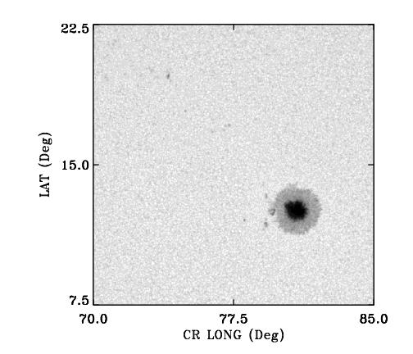
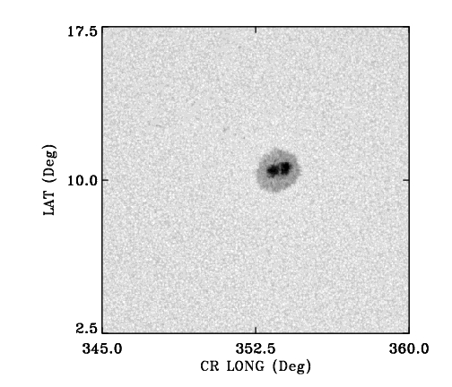
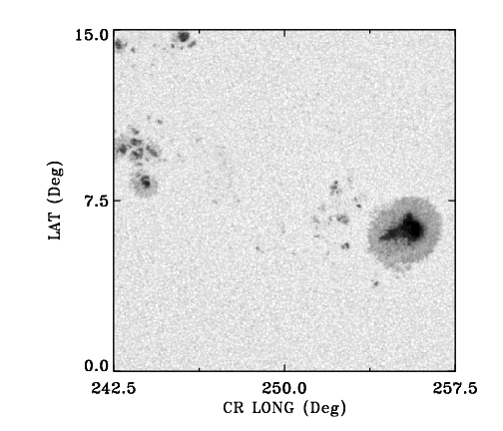
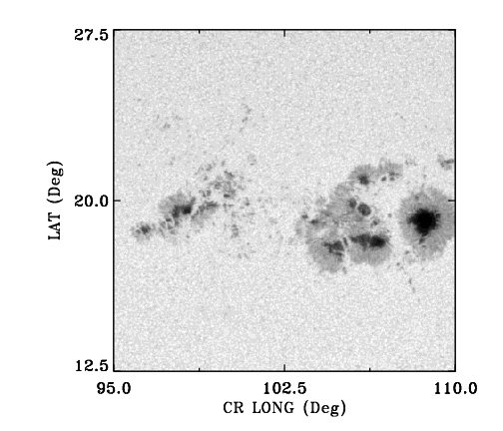
Data Selection
AR 11092
AR 11093
AR 11330
AR 11339
AR NOAO No | LAT (Deg) | CR LON (Deg) | Date | MAI (G) | MAI (G) (Quiet)
11092 | 15 | 77.5 | 20100803 | 40.8 | 0.98
11093 | 10 | 352.5 | 20100810 | 28.7 | 1.09
11330 | 12.5 | 10 | 20111028 | 119.5 | 1.02
11339 | 20 | 102.5 | 20111107 | 168.0 | 1.4

Slide 7
Flows from Local Correlation Tracking
HELAS VI, September 2, 2014

Slide 8
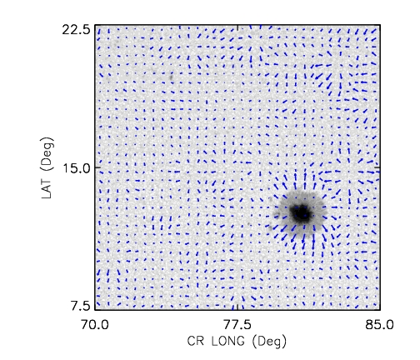
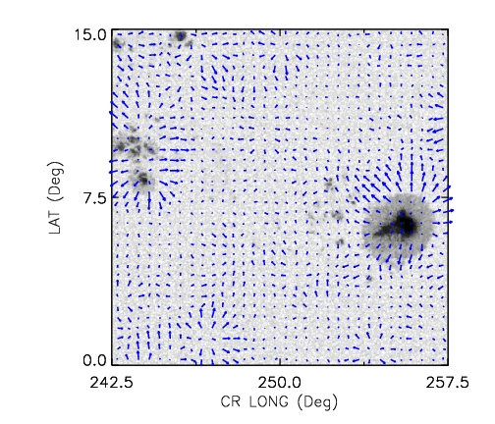
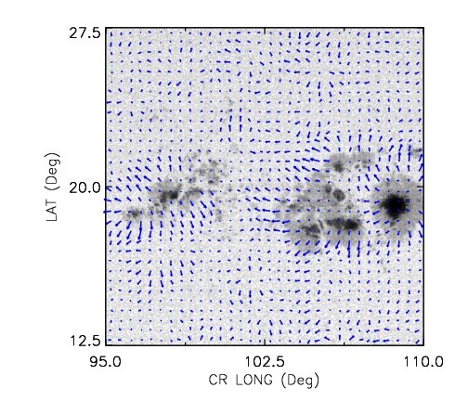
Flows from Local Correlation Tracking
AR 11092
AR 11093
Steady flows averaged over 1728 minutes.
Strong outflows (moat flow) from sunspots which is consistent with earlier studies.
Small inflows are also seen in the umbra
AR 11330
AR 11339

Slide 9
Comparison between Photospheric Flows from LCT and
Sub-photospheric Flows from RD
For each active region, we created a mosaic of tiles of 7.5°×7.5° spaced by 2.5° in each direction.
The flows calculated from the LCT were binned down to the same grid for comparison.
We compare the sub-surface flows in the 0.5 - 2 Mm range using (1) the fitted velocities of f-modes and (2) inverted horizontal flows.
HELAS VI, September 2, 2014

Slide 10
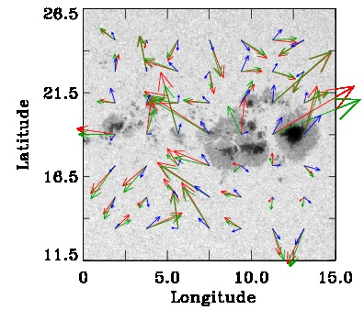
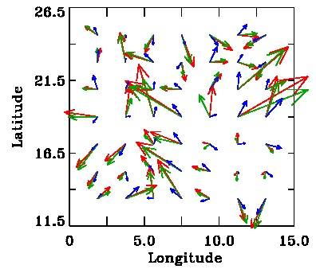
Horizontal Sub-surface Flows in AR 11339
(Depth range 0 – 2 Mm below the surface)
In order to include sufficient number of modes for better flow determination, we created a mosaic of tiles of 7.5°×7.5° spaced by 2.5° in each direction
Fitted Inverted LCT
HELAS VI, September 2, 2014

Slide 11
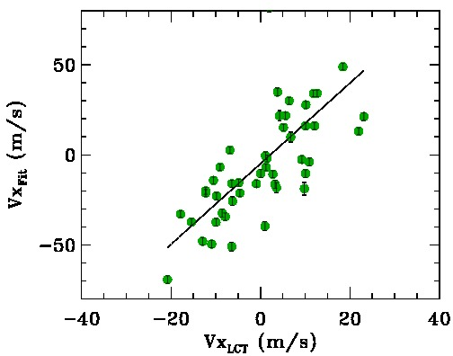
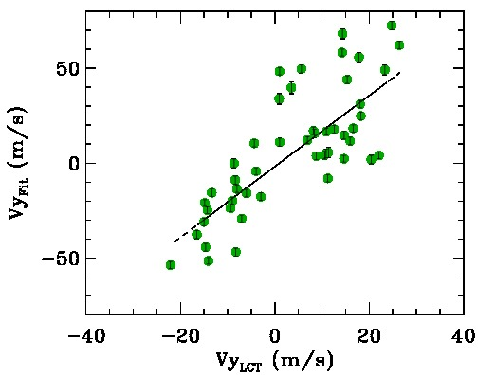
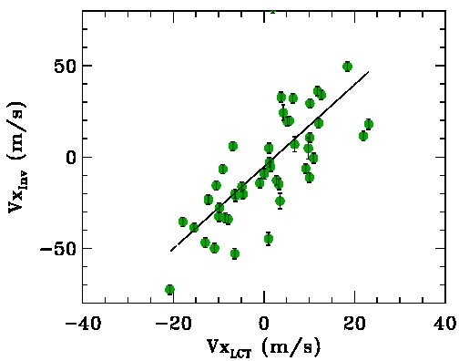
Comparison between Photospheric and
Sub-photospheric flows near Surface
Zonal Component
AR 11339
Meridional Component
r_{p} = 0.69
r_{p} = 0.78
From Helioseismology
Inverted Fitted
r_{p} = 0.71
r_{p} = 0.73
From surface features (LCT)
NSO-LPL Brown Bag Talk, August 13, 2014

Slide 12
Horizontal Flow
Magnitude and Direction
Inv r_{p} = 0.54
Fit r_{p} = 0.50
Inv r_{p} = 0.65
Fit r_{p} = 0.82
The magnitude and direction of the flow obtained from Fitted and Inverted velocities are in good agreement with LTC.

Slide 13
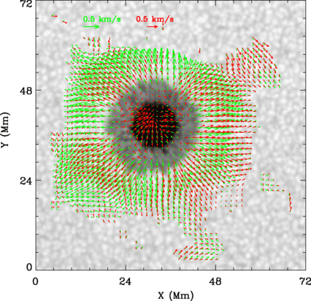
Comparison between Photospheric (DAVE4VM) and
Sub-photospheric flows (Time-distance)
AR 11084
TD
DAVE4vm
For a simple active region containing a round sunspot, inflow in umbra &
Outflow in penumbra are seen.
DAVE4VM: Differential Affine Velocity Estimator for Vector Magnetograms
Liu, Zhao & Schuck 2013, Solar Physics
HELAS VI, September 2, 2014

Slide 14
Comparison between Photospheric (DAVE4VM) and
Sub-photospheric flows (Time-distance)
AR 11084
Comparison of rp
r_{p} = 0.89
r_{p} = 0.76
 | RD | TD
Vx | 0.69 0.71 | 0.89
Vy | 0.78 0.73 | 0.76
V | 0.54 0.50 | 0.48
θ | 0.65 0.82 | 0.64
Fitted f-modes
Inverted
r_{p} = 0.48
r_{p} = 0.64
In both cases (RD & TD) , we find a poor correlation in |V | implying a gradient between the surface and sub-surface layers.
Liu, Zhao & Schuck 2013, Solar Physics
HELAS VI, September 2, 2014

Slide 15
Photospheric Flows from LCT as derived
from different Observables
Ins/Wavelength | Height above photosphere (km)
AIA 1600 | 480
AIA 1700 | 360
GONG * | 200
HMI V 6173 | 100
HMI Ic | 20
* Not used
HELAS VI, September 2, 2014

Slide 16
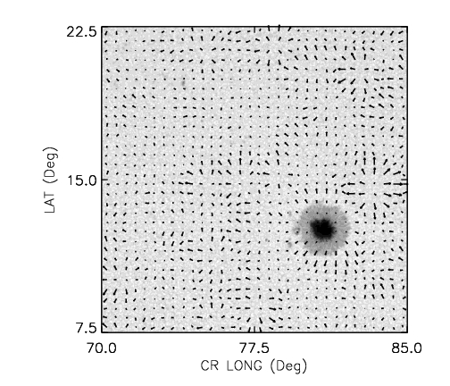
Photospheric flows from LCT
AR 11092
Intensity
AR 11339
HELAS VI, September 2, 2014

Slide 17
Photospheric flows from LCT
AR 11092
Intensity
Doppler
AR 11339
HELAS VI, September 2, 2014

Slide 18
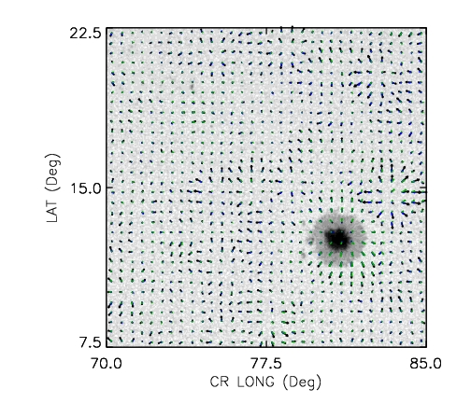
Photospheric flows from LCT
AR 11092
Intensity
Doppler
AIA 1600
AR 11339
HELAS VI, September 2, 2014

Slide 19
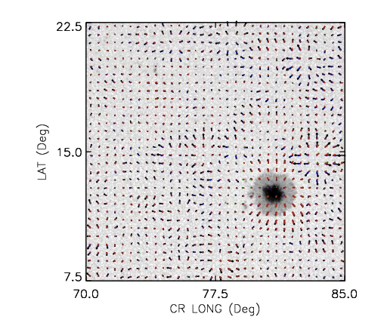
Photospheric flows from LCT
AR 11092
Intensity
Doppler
AIA 1600
AIA 1700
AR 11339
HELAS VI, September 2, 2014

Slide 20
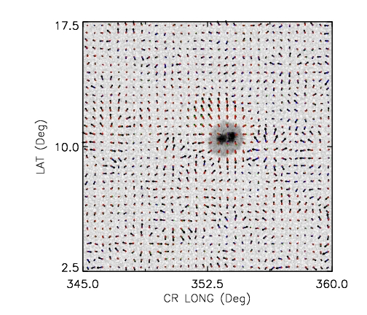
Photospheric flows from LCT
AR 11093
Intensity
Doppler
AIA 1600
AIA 1700
AR 11339
HELAS VI, September 2, 2014

Slide 21
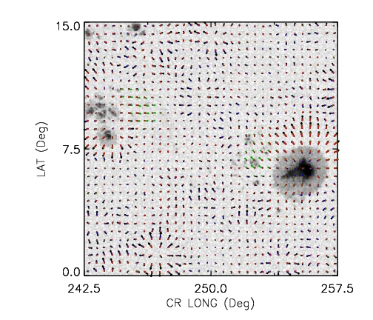
Photospheric flows from LCT
AR 11330
Intensity
Doppler
AIA 1600
AIA 1700
AR 11339
HELAS VI, September 2, 2014

Slide 22
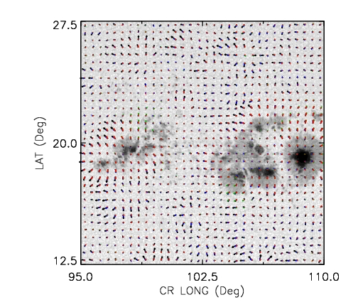
Photospheric flows from LCT
AR 11339
Intensity
Doppler
AIA 1600
AIA 1700
AR 11339
Photospheric Flows from different Observables as DERIVED using LCT agree reasonably well.
HELAS VI, September 2, 2014

Slide 23
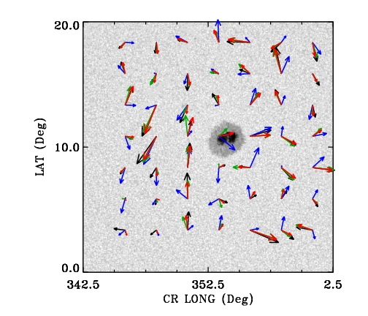
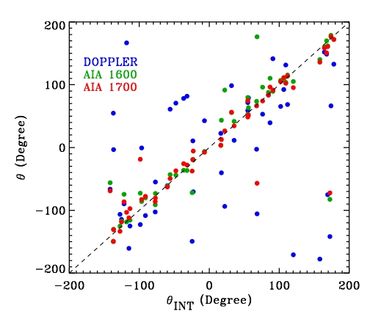
Comparison of subsurface flows in different observables
(using f-mode fitted velocities)
We use a mosaic of tiles of 5°×5° spaced by 2.5° in each direction
The subsurface flows derived from intensity observables agree better than the Doppler observation.
AR 11093
INT DOPPLER AIA1600 AIA1700
HELAS VI, September 2, 2014

Slide 24
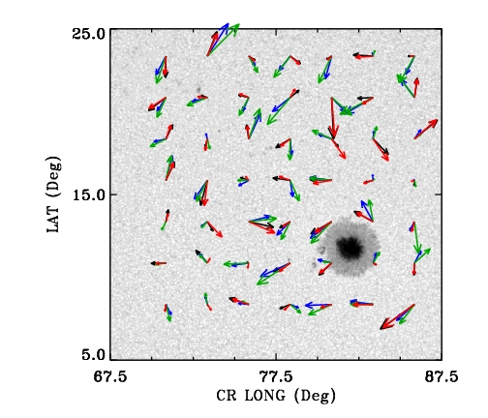
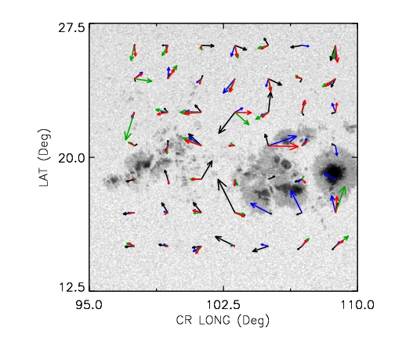
Comparison of subsurface flows in different observables (using fitted velocities)
AR 11092
AR 11330
AR 11339
INT DOPPLER AIA1600 AIA1700
The subsurface flows derived from intensity observables agree better than the Doppler observation.

Slide 25
Subsurface Inverted flows from different observables (averaged over 0-2 Mm)
INT DOPPLER AIA1600 AIA1700

Slide 26
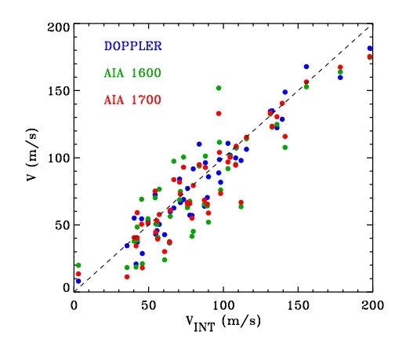
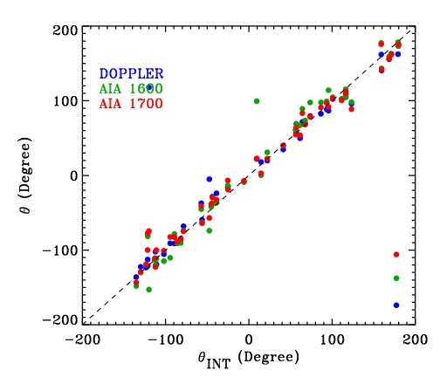
Scatter plots between different observables for AR 11093 (averaged over 0-2 Mm)
r_{p} = 0.57
0.94
0.95
r_{p} = 0.56
0.97
0.97
r_{p} = 0.44
0.90
0.91
r_{p} = 0.78
0.90
0.90

Slide 27
Summary
We have compared horizontal flow fields near the surface using helioseismology and local correlation tracking methods.
There is a strong correlation between photospheric and sub-photospheric flows near surface. The correlation coefficient for individual components of the flows is positive and significant. This clearly indicates that despite the absorption of acoustic power in active regions, the flows calculated using helioseismology techniques, e.g., ring-diagram technique, are reliable.
The surface or subsurface flows derived from different observables (using either LCT, fitted or inverted) agree reasonably well with other i.e. the inference of horizontal flows near the surface in active regions do not change significantly with the choice of spectral lines.
HELAS VI, September 2, 2014

