Slide 1
Seismic Monitoring of the Sun’s Far Hemisphere
Charles Lindsey
NWRA

Slide 2
Basics of Computational Seismic Holography
Far-side helioseismology is one of the major applications of solar acoustic holography, first proposed by Roddier (1975) as a solar-interior diagnostic.

Slide 3
Partial Reconstruction of the Acoustic
Helioseismic observations of the Sun’s surface are applied in time-reverse to the surface of an acoustic model of the Sun’s interior, propagated backwards into the model and sampled along a focal surface in the model interior

Slide 4
Multiple-Skip Holography of the Sun’s Far Hemisphere
The very thing that make it very difficult to detect acoustic anomalies more than a few hundred km beneath the photosphere makes almost the entirety of the Sun’s interior an exceptionally high-quality optical medium for acoustic waves. Muliple-skip seismology benefits from high-quality specular reflections of acoustic disturbance from the Sun’s surface. Multiple skip seismology involves waves with a higher spherical-harmonic degree (hence a shorter horizontal wavelength). This leads to a finer diffraction limit and a greater statistical weight for techniques that utilize the spatial acoustic spectrum opened thereby. Far-side seismic holography is based upon mapping of the phase shift between waves traveling toward the focus (green arrows) and their outcoming echos (yellow arrows).

Slide 5
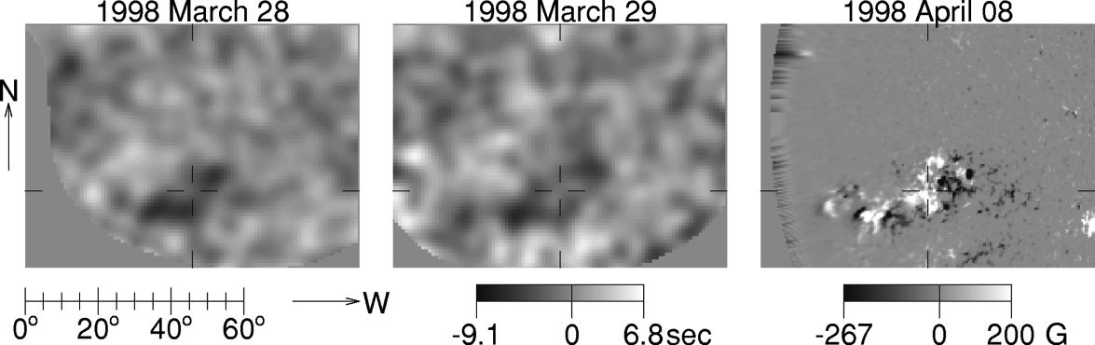
The First Acoustic Images of the Sun’s Far Hemisphere
Helioseismic signature of Active Regions 8194, 8195 and 8198 is seen approaching the meridian (from Earth perspective) in the Sun’s far hemisphere on 1998 March 28 (left frame) and crossing it on March 29 (middle frame). Left frame shows line-of-sight magnetogram of the complex having rotated across the Sun’s east limb into direct view from Earth.

Slide 6
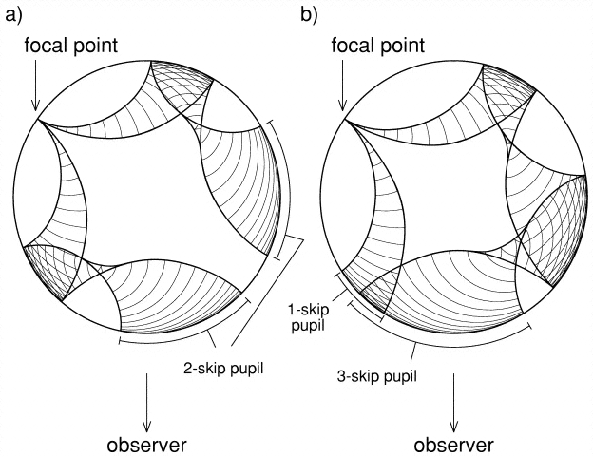
Seismic Coverage of the Full Far Hemisphere
The first far-side seismic maps were computed from the Doppler signatures of waves that had traveled form the near to the far hemisphere in two skips each way. These waves, represented in the left diagram could image the far hemisphere only out to an angle of about 40º from the antipode of disk center. Doug Braun worked out wave mechanics correlating waves that reach the focal point in a single skip with echos that travel three skips (right diagram) to cover focal points from 40º to the solar limb.

Slide 7

ὅν οἱ θɛοὶ ϕίλοῦσίνἀ ροθνῄσκɛί νέος
Irene González Hernández 1969--2014

Slide 8
Characterizing Active Regions in Terms of Area
To calibrate helioseismic signatures in terms of qualities familiar to active regions as viewed from the near hemisphere, Irene devised a scheme characterizing areas based upon magnetic (left) and continuum-intensity (right) thresholds

Slide 9
Relationship Between Active Region Area and Seismic Signature
Irene related helioseismic signatures to active-region areas in terms of both the mean seismic signature (left) over the region characterized and the maximum signature (right).

Slide 10
Calibrating Helioseismic Signatures in Terms of Magnetic Field
Irene used statistics comparing far-side seismic signatures of active regions with previous and subsequent near-side signatures (data points) to derive the calibration curve represented by the solid curve.

Slide 11
Autocorrelation of Magnetic Field Strength Before and After Far-Side Transit
Comparisons between seismic signatures of active regions in the far hemisphere and their magnetic signatures in the near hemisphere (previous figure) suggest a rather weak correlation. The correlation between near-side magnetic signatures from before and after transit through the far hemisphere (above) indicate that this is mostly the result of evolution of the active region as it rotates from the far hemisphere to the near hemisphere.

Slide 12
Far-Side Helioseismic Synoptics
As part of her program to evaluate the reliability of seismic signatures of active regions, compiled synoptic seismic maps of the Sun’s far hemisphere, identified seismic signatures prospective of solar activity and compared them with line-of-sight magnetograms of the regions before and after their transits of the far hemisphere. The top frame in this figure shows the line-of-sight synoptic magnetic map for Carrington Rotation (CR) 2009. The bottom shows the same for CR 2010. The middle frame shows the seismic synoptic map representing respective regions when they were in the far hemisphere, between rotations.

Slide 13
The Far-Side Monitor Applied to GONG Doppler Observations
Irene’s work was crucial in adapting the holography algorithm for applications to GONG Doppler observations. Comparisons between far-side seismic map computed from MDI and GONG seismic observations show a high correlation, both in signal and realization noise, suggesting that the noise is solar in origin, hence, two instruments give us very similar representations of solar acoustic noise.

Slide 14
First Far-Side Active Region of Cycle 24
Active Region 11026, the second in Solar Cycle 24, was born in the Sun’s far hemisphere. Irene used this map of the far hemisphere to blow the whistle on this region crossing the far-side meridian on 2009-09-14, a week before it rotated across the east limb into direct view from Earth (and about two days before it became visible to STEREO B).

Slide 15
Improvements in the Far-Side Maps
Irene worked with Charlie Lindsey and Doug Braun on a range of initiatives to improve the quality of far-side seismic maps. The comparison above shows results of a major such effort: Left frame shows a far-side map computed from the original pre-processed Doppler maps condensed to compact arrays and Postel-projected onto 200X200-pixel maps. Right frame shows the same computed from 1024X1024 maps Postel-projected to 1600X1600-pixel maps, which were then condensed to 200X200-pixel maps. The latter scheme circumvents the loss of limbward p-modes as a result of foreshortening.

Slide 16
Applications of Far-Side Seismic Monitoring
The following applications involve the work of many authors. Irene was crucial in motivating this work. These applications are summarized only briefly here. For a more complete discussion, Frank Hill’s presentation is highly recommended.
UV Irradiance Forecasting
Forecasting of Flare Potentiality
Forecasting of the Coronal Magnetic Field
Source ID for CMEs from the Far Hemisphere
Studies of Active-Region Evolution
Diagnostics of Helioseismology Itself

Slide 17
Observed-Activity and Obsolescence Maps for Solar UV-Irradiance Forecasts
The far-side seismic monitor can show us active regions in the far hemisphere that emerge into the “obsolete” (non-blue) region.

Slide 18
Applications of the Far-Side Seismic Monitor to Solar Irradiance Forecasting
Irene collaborated with Juan Fontenla and colleagues in a study that showed how the far-side seismic monitor, together with SoHO/SWAN, considerably improves forecasts of the solar UV irradiance (see dash-dot-dashed profile labeled “SRPM,” by its identification of active-regions newly emerged in the far hemisphere. The far-side seismic monitor is now an integral part of solar irradiance forecasting.

Slide 19
Far-Side Events that Effect Earth
The halo-CME shown in the upper-right frame apparently emanated from an active region in the far hemisphere, the helioseismic signature of which is shown in the lower-right frame (noting the lack of X-rays in the lower-left frame). In this instances, the CME accelerated protons to hundreds of MeV, some of which showered the near-earth environment, on QQDATE. This happened during an extra-vehicular activity (EVA) at the International Space Station (ISS). Such events are rare, grounds for concern when helioseismic signatures show strong activity in the far hemisphere.

Slide 20
The SDO Far-Side Seismic Solar Monitor
http://jsoc.stanford.edu/data/farside
Comments addressed to clindsey@cora.nwra.com are welcome.

Slide 21
Composite Maps of the Near and Far Hemisphere
Seismic signatures of active regions in the Sun’s far hemisphere are represented in travel-time deficits in amber, with line-of-sight magnetic signatures represented in Gauss in gray-blue over a 12-day period. AR 11890 is seen rotating across the east limb at Carrington longitude 170 and latitude 12 S from 2013-11-01 to -04.

Slide 22
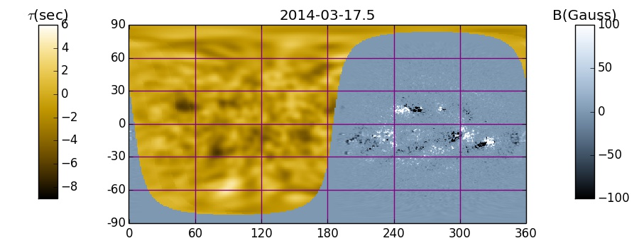
Composite Seismic-Magnetic Maps

Slide 23
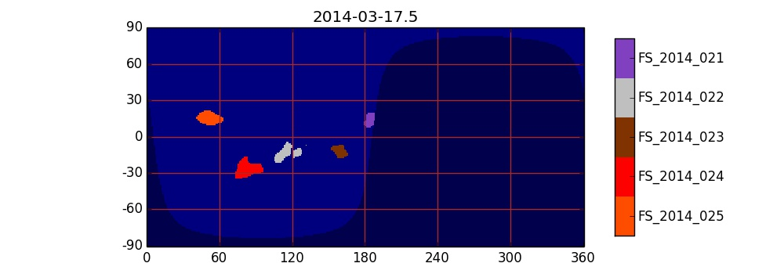
Large Active Region Maps

Slide 24
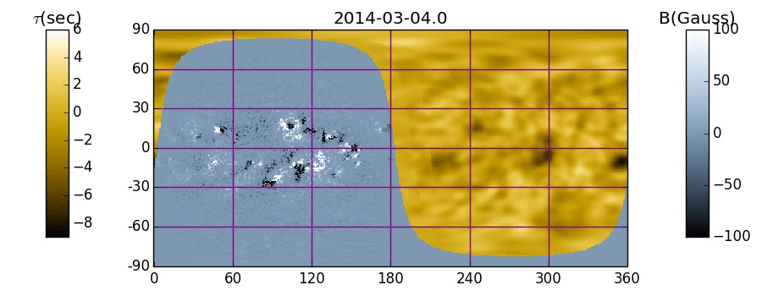

Composite Movie
(1/2 Solar Rotation)

Slide 25
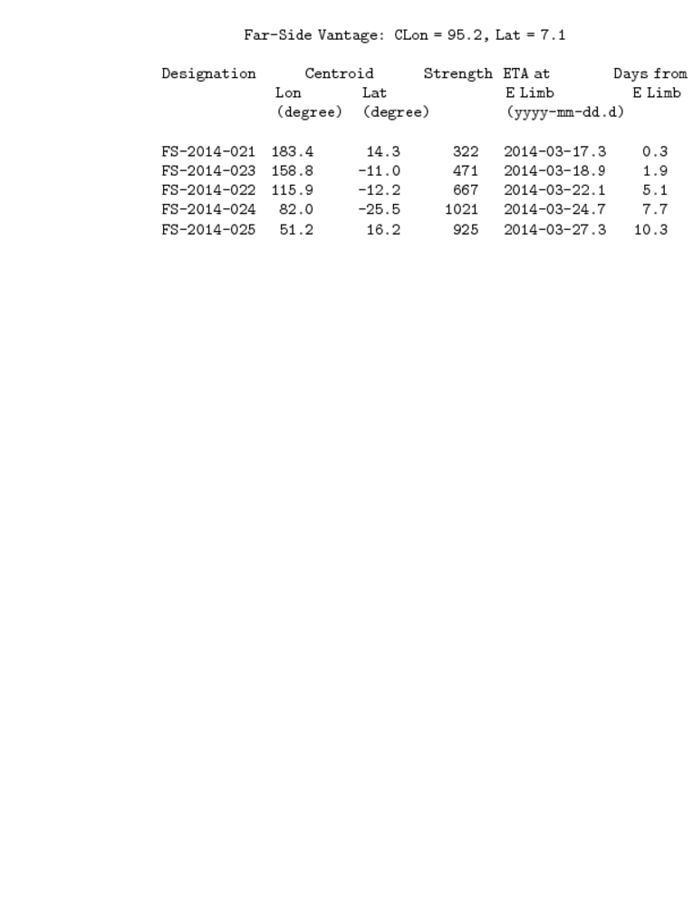
Large Active Region Tabulation

Slide 26
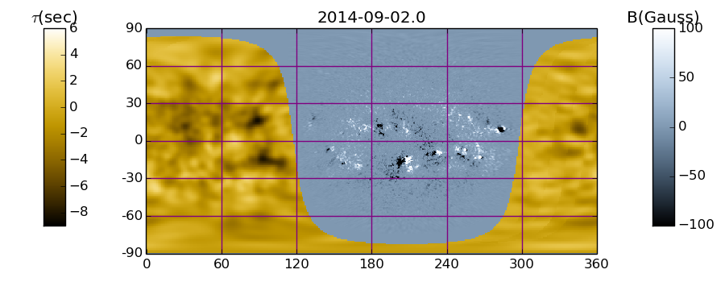
The Sun’s Far Hemisphere Today

Slide 27
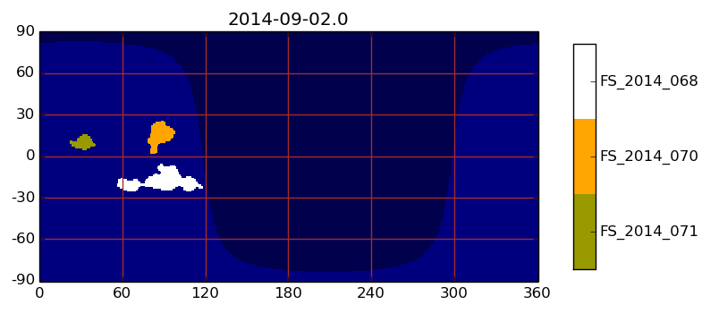
The Sun’s Far Hemisphere Today

Slide 28
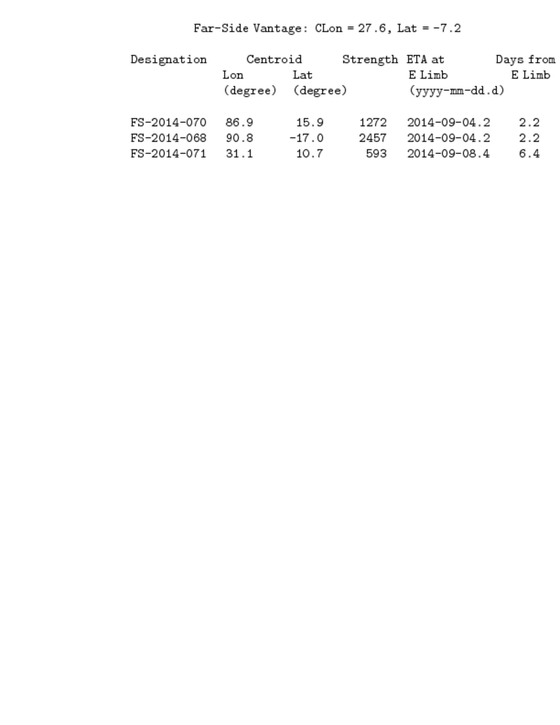
HMI Table of Large Far-Side Active Regions on 2014-09-02

Slide 29
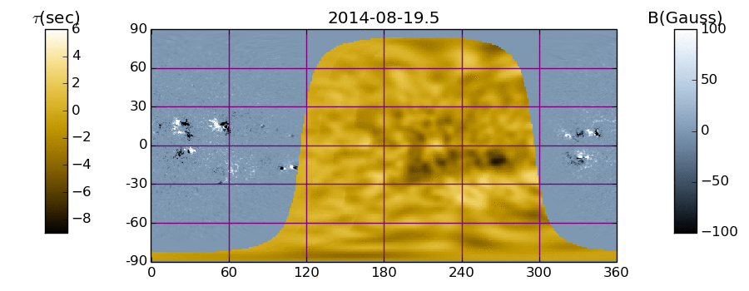

Movie of Far-Side Maps over a Half Solar Rotation Ending on 2014-09-02

Slide 30
Summary
Irene Gonzalez Hernandez’s life and work have been a great benefit to solar research and its applications to 21st century technology. Irene was a key player in the development of local helioseismology and its practical applications to space-weather forecasting and other areas of solar research. Her role in seismology of the Sun’s far hemisphere is especially crucial, both in its technical development into the diagnostic tool it is today, and in opening the market for its many applications. At the turn of the century, far-side seismology was a precarious, highly experimental proposition with an intimidating array of operational and quality-control issues. Irene’s hard work, dogged persistence and patience were essential in resolving these problems and making far-side seismology the flexible, practical space-weather forecasting tool it has since become, applied to SoHO/MDI, GONG and SDO/HMI observations. And, Irene accomplished all this with contagious exuberance, enthusiasm and never-failing cheer and good humor. She was a very open, loving, caring personality, always a team player, and an unfailing pleasure to work with. Irene visited our world for a little while and left it a better place. Many are those who will keep a special warm place in their hearts for Irene and treasure her memory.

