Slide 1


Chromospheric magnetic fields with the EST:
A new era for He 10830
Andreas Lagg
MPI for Solar System Research
Katlenburg-Lindau, Germany
lagg@mps.mpg.de

Slide 2
Motivation
Why He 10830?
purely chromospheric
B-range 1 G to several kG
ideal for coupling science
height diagnostic tool!
off-limb AND on-disk ‘easy’ to interpret

Slide 3
Motivation
Why with EST?
photon efficiency
→ high photon flux
spatial & temp. resolution
high polarimetric accuracy
(“polarization-free” telescope)
image stability (MCAO)

Slide 4
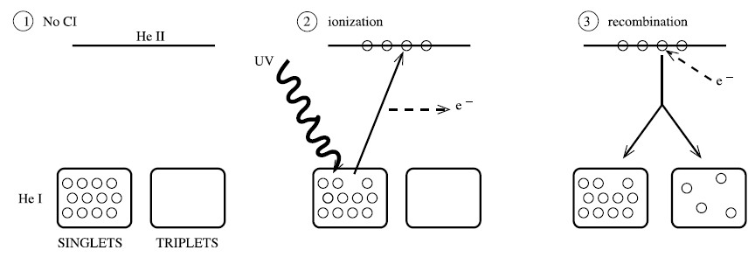
Ionization / Recombination Scheme
Centeno et al., 2008
Advantage: NO photospheric contribution!
Disadvantage: Coronal illumination required

Slide 5
Para / Ortho Helium
Centeno et al., 2008

Slide 6
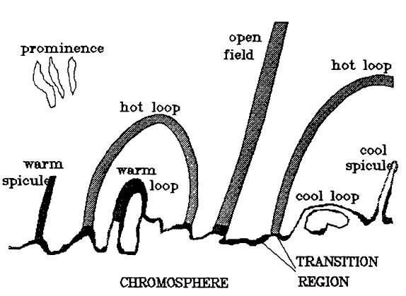
He 10830
Formation Height
Avrett et al. (1994)
Notes:
Chromosphere extremely warped surface.
this is a problem - stratification not so easy to determine.
Solution: Stereoscopy, Off-Limb, OR: He 10830

Slide 7
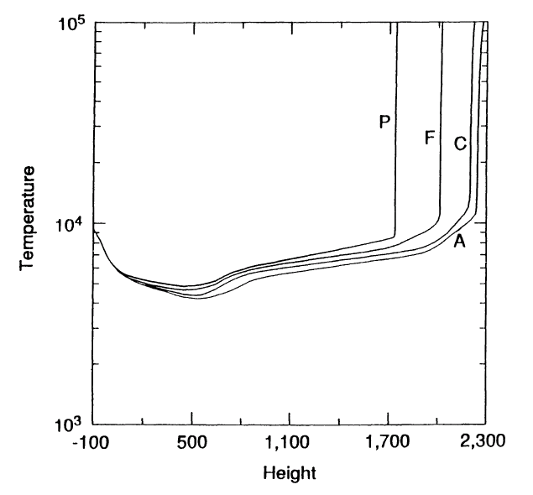
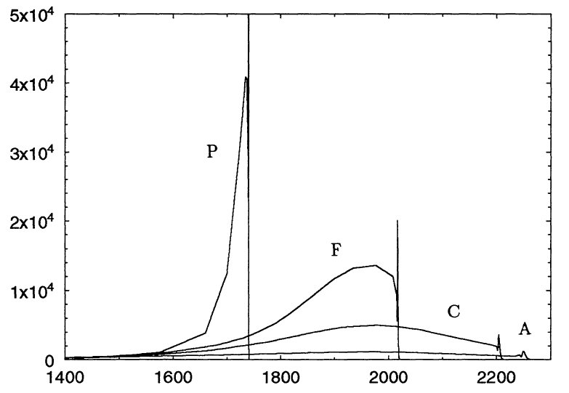
He 10830
Formation Height
important parameters for He formation:
density and extent of chromosphere
coronal illumination
plage
bright network
He density ³S₁
average
cell center
Avrett et al. (1994)
Notes:
cool He loops can extend to much higher layers
model atmospheres:
T-profile → (hydrost. equ.) → pressure
models A (cell-center), C (average), F (bright network), P (plage)
CH/CL hi/lo coronal irradiance

Slide 8
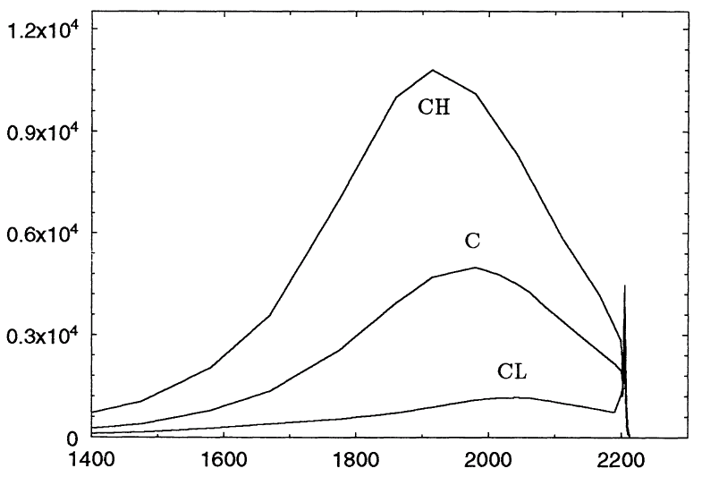
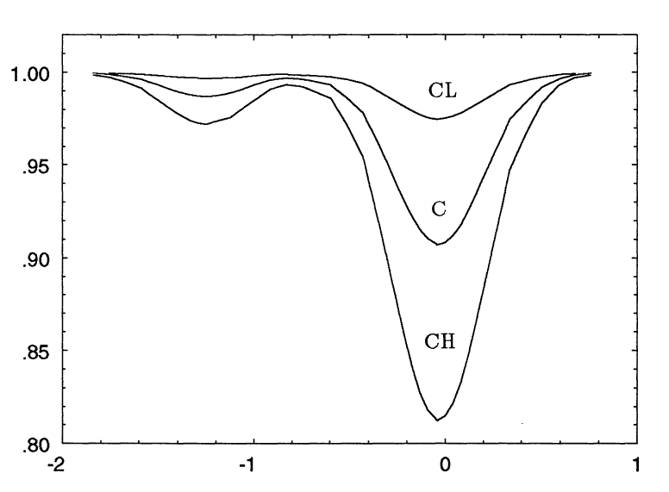
He 10830
Formation Height
important parameters for He formation:
density and extent of chromosphere
coronal illumination
He density ³S₁
Stokes I
Avrett et al. (1994)
Wavelength [Å]
Notes:
model atmospheres:
T-profile → (hydrost. equ.) → pressure
models A (cell-center), C (average), F (bright network), P (plage)
CH/CL hi/lo coronal irradiance

Slide 9
He 10830
Photospheric Contribution
None.
No complex non-LTE modelling of the solar atmosphere required.
Simple interpretation
→ analysis of complex solar conditions possible

Slide 10
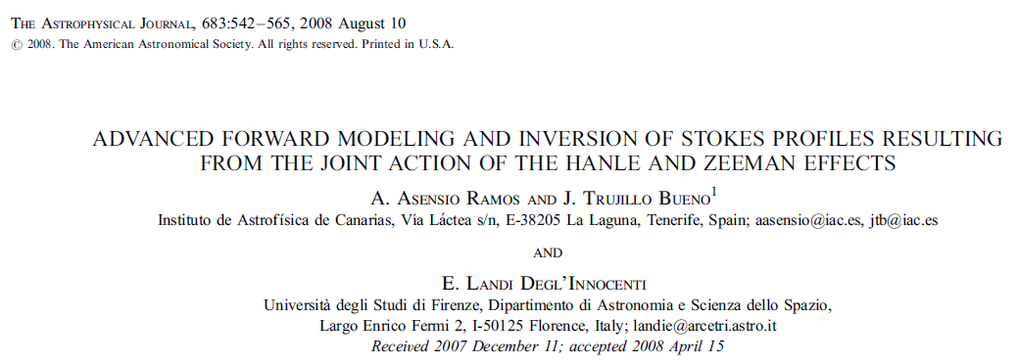
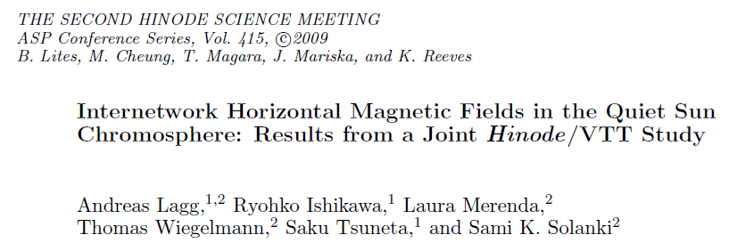
He 10830
Analysis Techniques
Advanced inversion codes available:
HAZEL (Asensio Ramos et al. 2008)
(HAnle and ZEeman Light)
HeLIX⁺ (Lagg et al., 2009)
(Helium Line Information Extractor),
based on similar synthesis module

Slide 11
Sensitivity of He 10830 to magnetic field
Animation next slide:
INC=80° to solar vertical
formation height: 2000 km
broadening: 8 km/s
optical thickness: model ‘C’
0 <= B <= 500 G
location: disk center

Slide 12
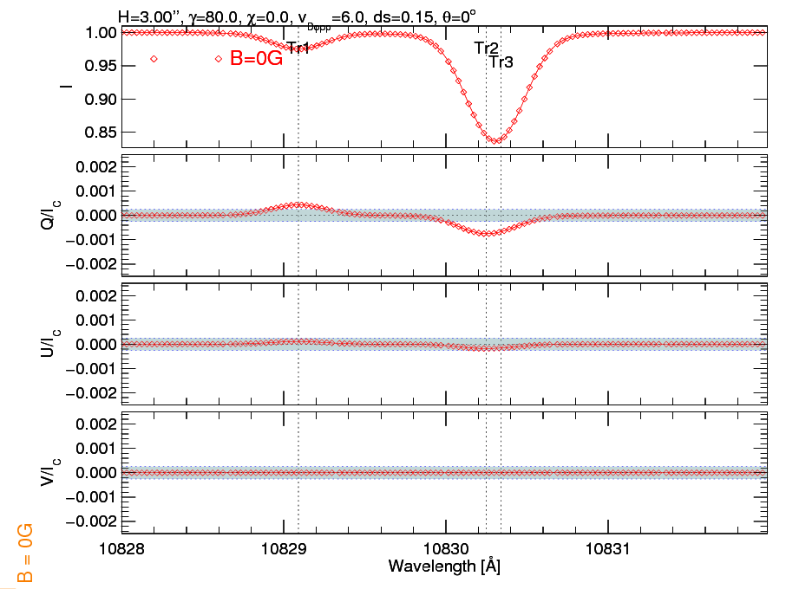
Sensitivity of He 10830 disk center case

Slide 13
Sensitivity of He 10830 to magnetic field
Animation next slide:
INC=80° to solar vertical
formation height: 2000 km
broadening: 8 km/s
optical thickness: model ‘C’
0 <= B <= 500 G
location: close to limb (Θ=89°)

Slide 14
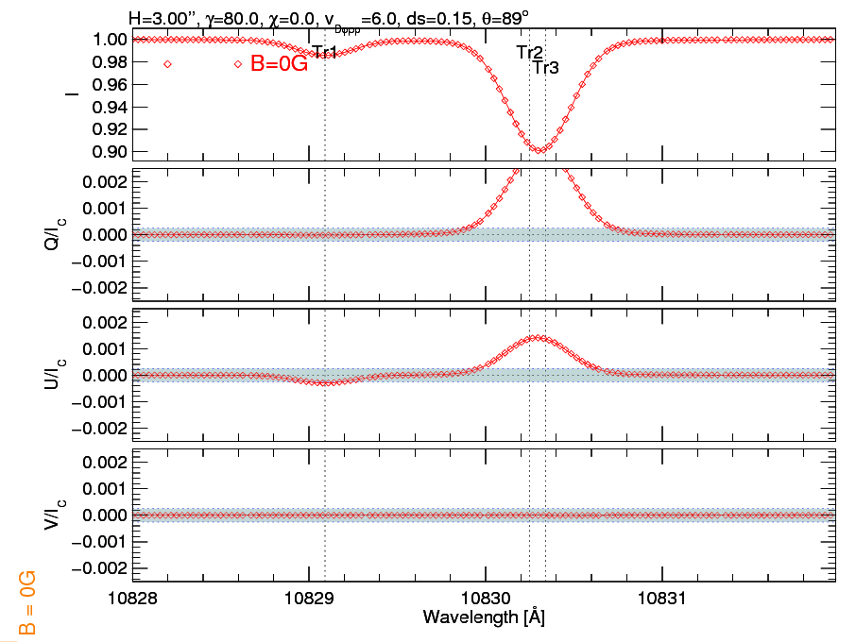
Sensitivity of He 10830 close to solar limb

Slide 15
Sensitivity of He 10830 to height
Animation next slide:
INC=80° to solar vertical
formation height:
500 - 15000 km
broadening: 8 km/s
optical thickness: model ‘C’
B = 100 G
location: disk center

Slide 16
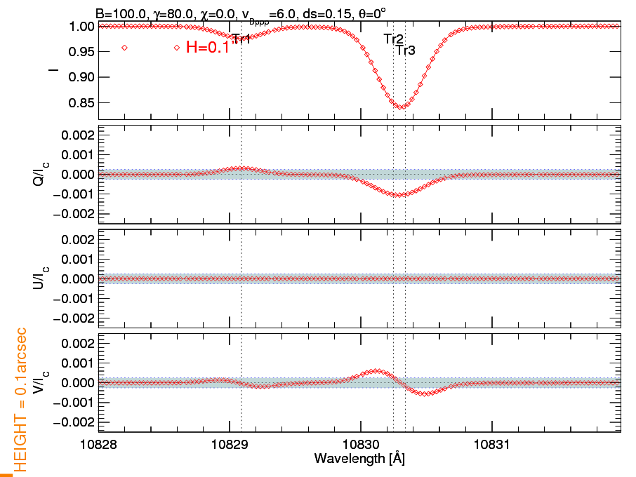
Sensitivity of He 10830 to height disk center case

Slide 17
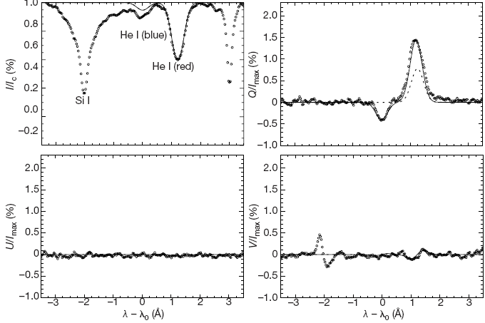
On disk measurements: filaments (He absorption)
forward scattering → linear pol. in red & blue line
Trujillo-Bueno, 2001
Notes:
lower level Jl=1 can carry polarization → in absorption all three lines show lin. pol.

Slide 18
Offlimb measurements: prominences (He emission)
90° scattering → linear polarization only in red line
90° scattering → linear polarization only in red line
Trujillo-Bueno, 2001
Notes:
blue line: Ju=0 → cannot carry atomic polarization
red lines (Ju=1, Ju=2) can carry atomic polarization

Slide 19
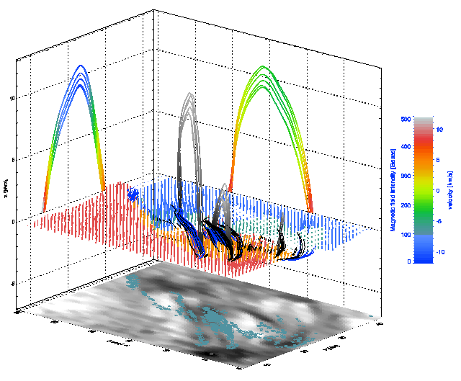
Science Examples: 3D Chromosphere
Right projection: Vertical velocity
Left projection: Field strength
Emerging loops are cool & hence well visible in He I
Solanki et al., 2007

Slide 20
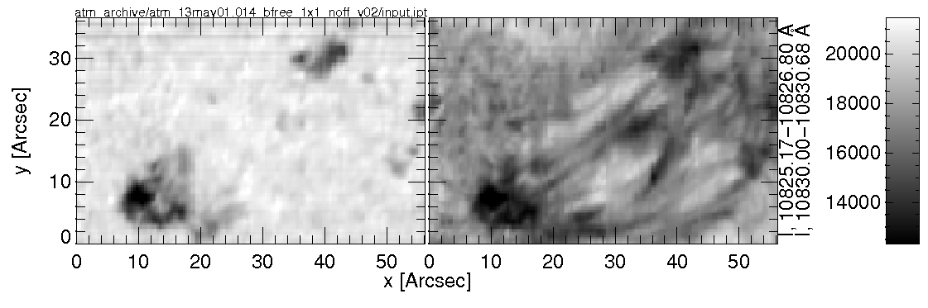
Height Information:
Apex of emerging loops
Where does the He absorption come from?
layer of constant height (Judge, 2009)
from a loop connecting the footpoints
Photosphere
Chromosphere

Slide 21
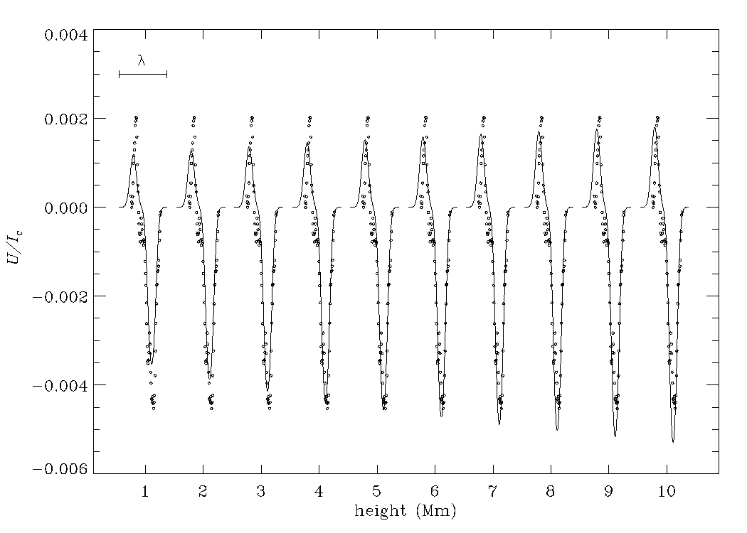
Height Information:
Apex of emerging loops
5-7 Mm can reproduce Stokes U
layer of constant height
Merenda et al., 2010

Slide 22
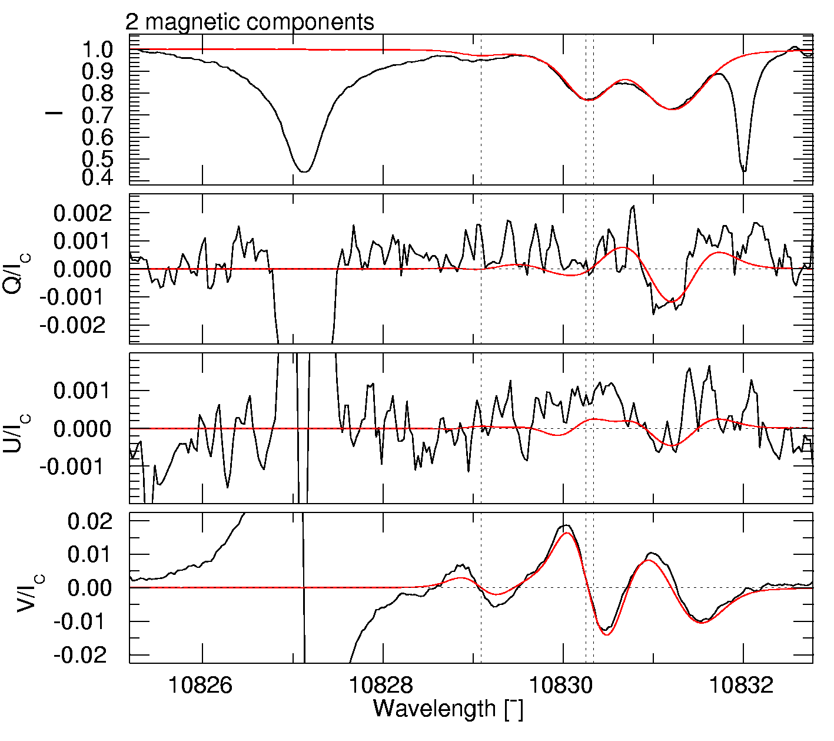
Science Examples: Multi component downflows
determine magnetic field for both velocity components
determination of B for both components possible
gas flows along different field lines!
EST: recover unresolved fine-structure
Slow comp.
VLOS B INC AZI
-620m/s 520G 35° 90°
Fast comp.
VLOS B INC AZI
24900m/s 730G 60° 60°
Lagg et al., 2007

Slide 23
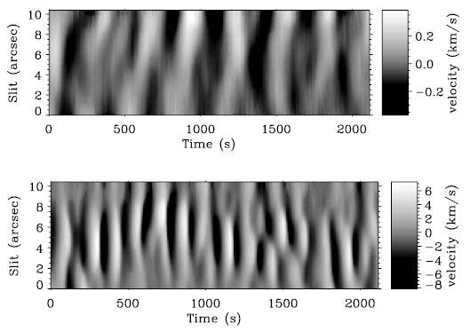
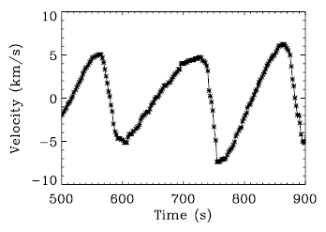
Coupling science:
Si 10827 / He 10830
Centeno et al. (2006)
Bloomfield, Lagg et al. (2007)
sunspot umbra:
velocity oscillations in Si 10827 and He 10830
5 min in photosphere
3 min in chromosphere
sawtooth in chromosphere
model: isothermal, stratified atmosphere with radiative cooling, field aligned, acoustic waves
photosphere contains significant power in 6 mHz (3´), penetrates directly to chromosphere
sound waves only penetrate above 4 mHz (5´ do not reach chromosphere)
Notes:
Newtons cooling law: accounts for damping of temperature fluctuations due to radiative losses.
free parameters temperature, height difference Si ß He and radiative cooling time tauR
parameters for one spot, 2nd spot slightlz different, but same dy
filtering: take amplitude of oscillation at a selected frequencz. shift photospheric spectrum to match chromospheric spectrum.
shifts: 38s for 4-5 mHz, 242s for 5-6 mHz, 248s for 6-7 mHz
upward propagation
verz nice agreement with theoretical values!
shocks:
As the photospheric perturbations
propagate upward, their amplitude increases due to the rapid
decrease in density, and they eventually develop into shock waves
at chromospheric heights.

Slide 24
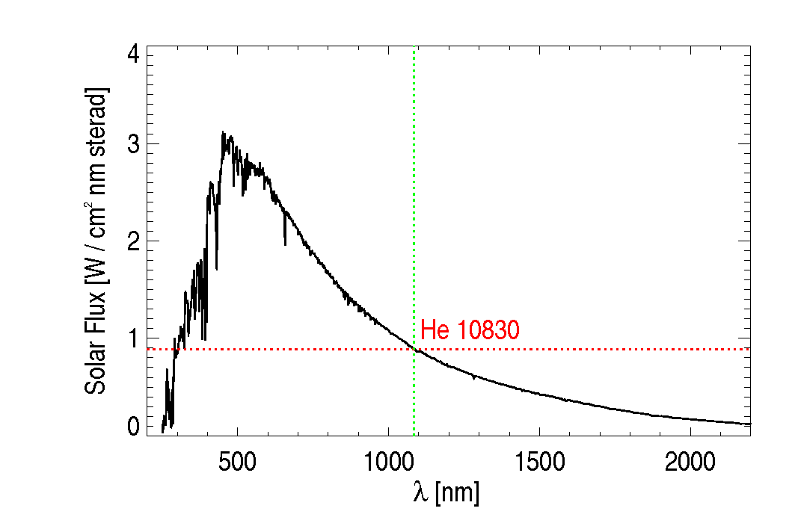
EST performance:
Photon budget
aperture: 4m
total efficiency (incl. detector): 5%
exp. time for full Stokes: 10s

Slide 25
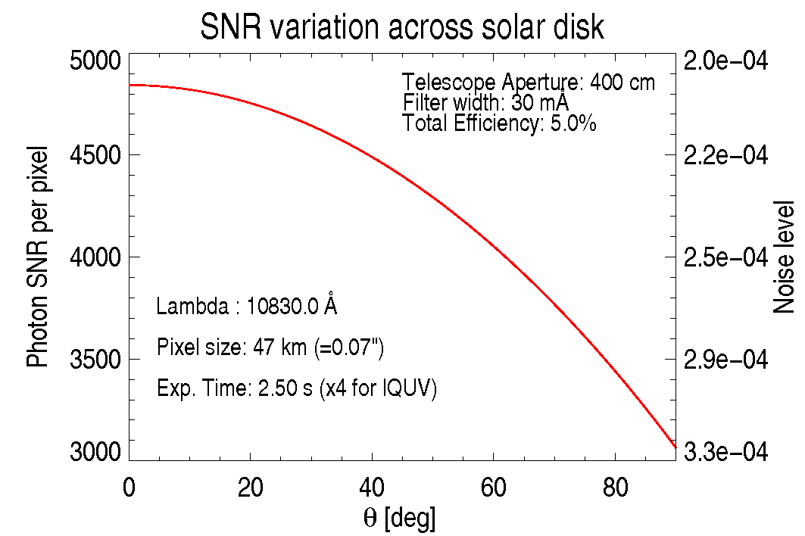
EST Performance: expected noise level

Slide 26
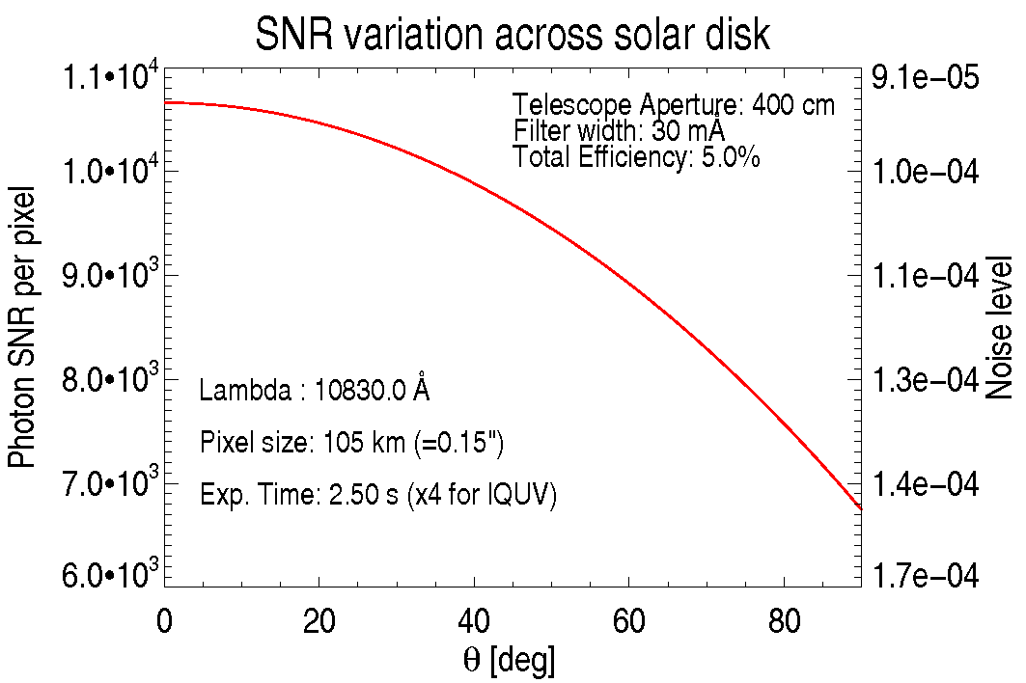
EST Performance: expected noise level

Slide 27
Comparison with VTT
VTT Throughput estimation
(German Vacuum Tower Telescope – The He 10830 workhorse)
at VTT diff. limit resolution: 0.36” pixel size
→ noise level 4-5 E-04
throghput: ~1.7% (EST: factor 3-4)
photons: factor 15-20
resolution: factor 5

Slide 28
Concerns for using He 10830
Quiet Sun:
Is the He 10830 signal sufficiently strong to perform useful measurements in quiet regions?

Slide 29
TIP2 + SOT SP Campaign April/May 2008

Slide 30
TIP2 + SOT SP Campaign April/May 2008

Slide 31
Full Hanle Inversions: noise level 2e-4
B=70 G
INC_{solar}=70°
h=2100 km
AZI=aligned with visible structure
The high photon efficiency and polarimetric accuracy of EST will allow for measurements in quiet Sun regions!

Slide 32
He 10830:
Pros & Cons
relatively weak in quiet Sun
BUT: always purely chromospheric!
Height information contained in Stokes spectra
Gradient analysis: narrow slab
→ no gradients observable
BUT: nearby Si line allows for phot./chrom.
gradient studies
spatial resolution: Ca H, K better by a factor of 3
BUT: simple analysis
→ fine structure can be obtained with indirect
techniques (e.g. multi-component modeling)

Slide 33
New Science with He 10830
@ EST: hi-res, high S/N
Spatial Resolution: ~0.15” and better
studies of chromospheric fine structure (fibrils, spicules)
Temporal resolution:
high cadence allows studies of short-lived structures (eg. type-2 spicules)
S/N ratio: low straylight increases signal strength in individual profiles
→ analysis of Stokes profiles is simpler
→ ‘boost’ for chromospheric science

Slide 35
Conclusions
Active regions (plage, pores sunspots):
reliable measurements for B > 100 G are easy.
Extremely high spatial and/or temporal resolution
coupling science: photosphere / chromosphere
Quiet regions:
10 – 100 G: saturated Hanle regime:
LP determined by direction of B
<10 G: Hanle sensitive regime: LP depends on direction and on strength of B
noise level of 10⁻⁴ or better required
EST: offers
stability (MCAO)
low straylight: small fields easier detectable
highly photon efficient instrument
→ ‘boost’ for chromospheric science

Slide 36
Science Examples: Filaments
He 10830 intensity
Inclination
Azimuth
Merenda et al., 2006
Notes:
We note that the inclination of the magnetic field changes along the lament and is almost horizontal is its central part, whereas its azimuth changes according to the changes in the orientation of the main axis of the filament
Strength: 100 G regime, depends on height of filament difficult to determine)

Slide 37
Coupling Science:
Running Penumbral Waves
Bloomfield, Lagg et al. (2007)
first mentioned by Zirin & Stein
describe chromospheric Hα velocity and intensity fronts that were observed moving out through sunspot penumbrae
photosphere: dominant power at 5’, 2nd peak at 3’
chromosphere: 3’ above umbra, 5’ above penumbra, running outwards
Photosphere
Chromosphere
Umbra
Lightbridge
Umbra
Penumbra
Quiet Sun

Slide 38
Coupling Science:
Running Penumbral Waves
extension of work of Centeno et al. (2006): waves travelling along inclined field lines
alignment between photospheric and chromospheric pixels:
→ requires knowledge of magnetic field inclination
(determined from inversions in Si and He)
Notes:
unlike in the umbra a careful pixel alignment between photosphere and chromosphere must be done, since the waves do not propagate vertically, but along the magnedif field lines

Slide 39
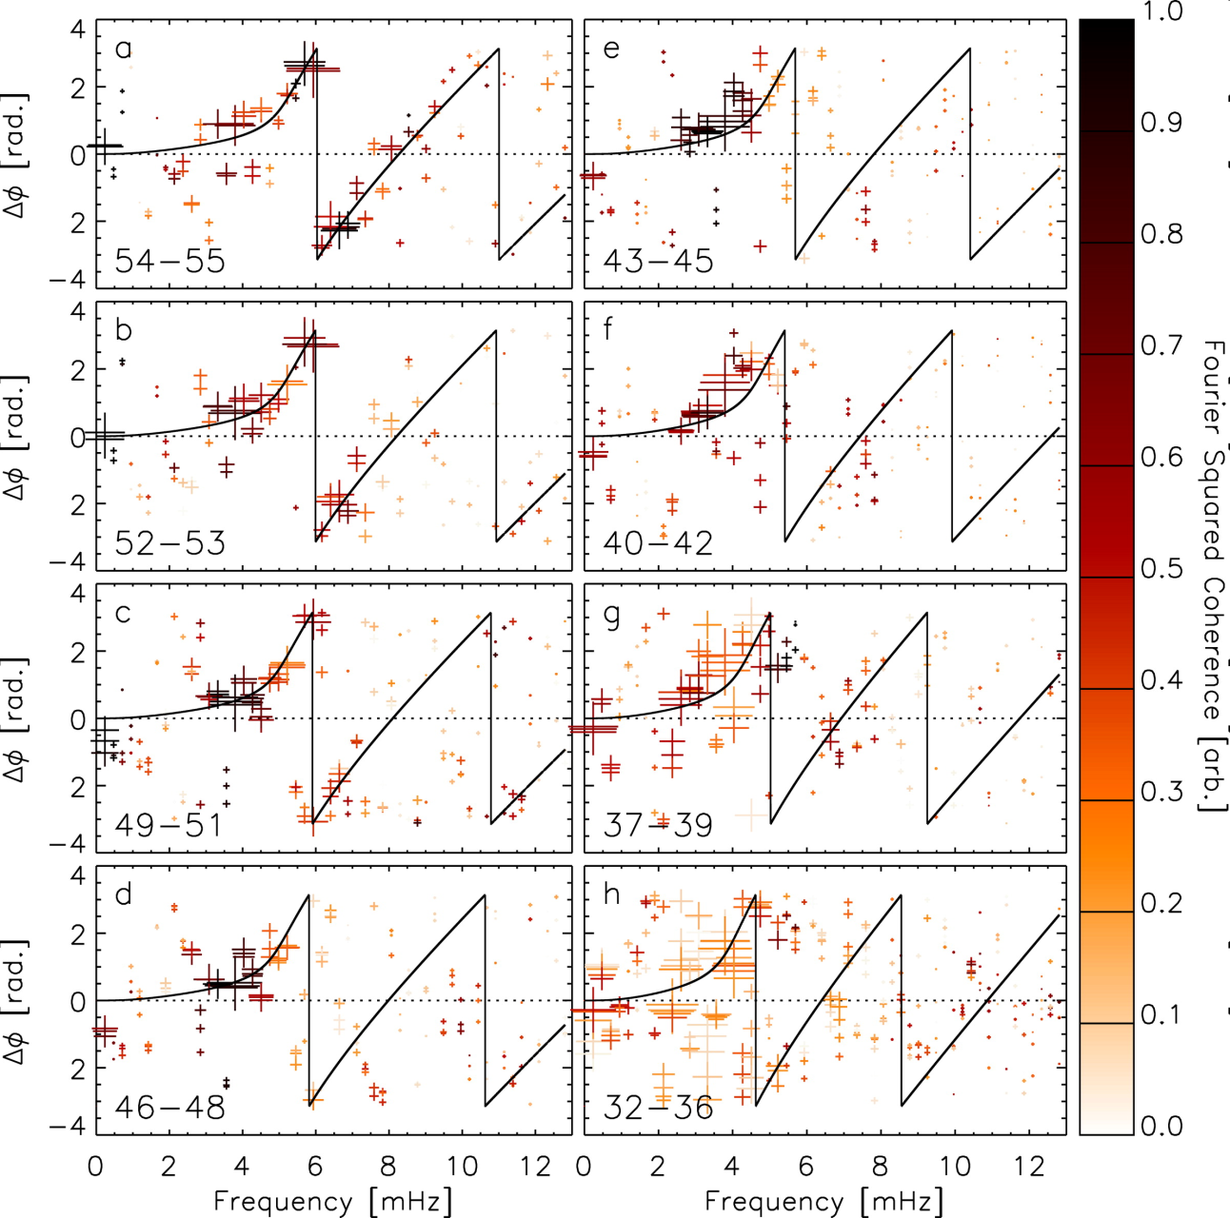
Coupling Science:
Phase difference analysis
Model: acoustic-like (low β slow mode) wave, (reduced gravity, increased path length)
Phase differences for spatially offset dual-height pairs of photospheric and chromospheric pixels.
solid: phase diff. for model wave (modified acoustic dispersion relation) using the measured Si field inclinations.
RPWs are a ‘‘visual pattern’’ resulting from field-aligned waves propagating up from the photosphere.
Notes:
Symbol size and shading denote cross-spectral power and squared coherence, respectively.

