Slide 1
Sunrise inversion Strategies
Andreas Lagg

Slide 2
The IMaX spectral environment

Slide 3
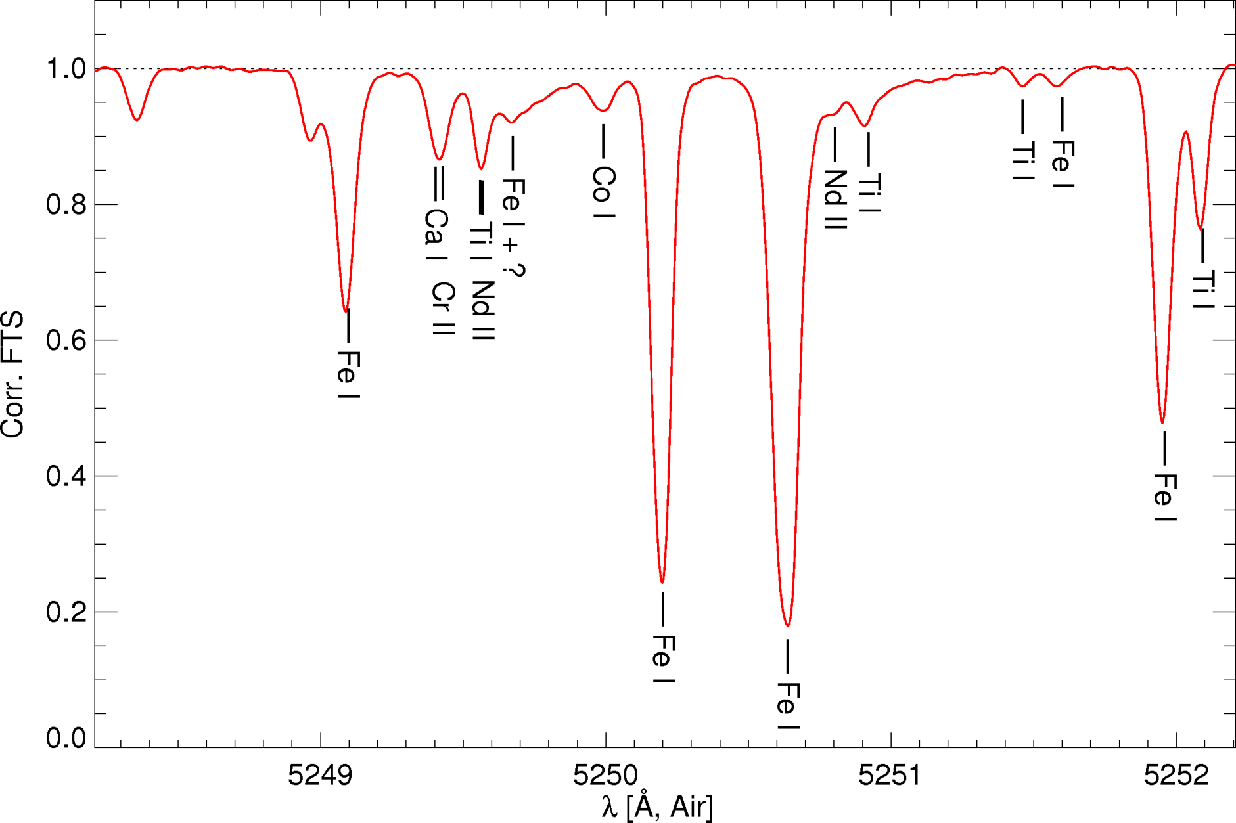
The IMaX spectral environment

Slide 4
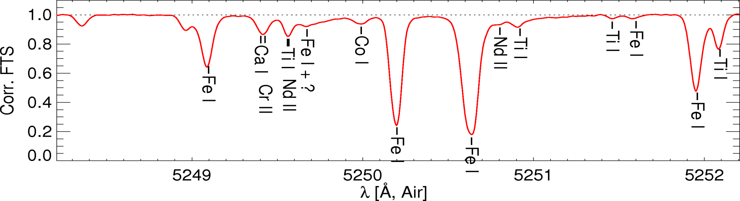
The IMaX spectral environment
Line | WL [Å] | Landé-factor | Δλ_{Zeeman} @ 2kG [mÅ] | Δ to IMaX-line [mÅ] [km/s] |  | FWHM [mÅ]
Fe I | 5249.1050 | 0.917 | 23.6 | 1103 | 63.0 | 94
Ca I | 5249.4110 | 1.500 | 38.6 | 797 | 45.5 | 94
Cr II | 5249.4370 | 1.600 | 41.2 | 771 | 44.0 | 94
Ti I | 5249.5680 | 0.750 | 19.3 | 640 | 36.6 | 87
Nd II | 5249.5760 | ?? |  | 632 | 36.1 | 87
Fe I | 5249.6820 | 1.208 | 31.1 | 526 | 30.1 | ?
Co I | 5250.0000 | 0.786 | 20.2 | 208 | 11.9 | 121
Fe I | 5250.2080 | 3.000 | 77.2 | 0 | 0 | 82
Fe I | 5250.6450 | 1.500 | 38.6 | 437 | -25.0 | 116
Nd II | 5250.8040 | ?? |  | 604 | -34.5 | ?
Ti I | 5250.9300 | 1.000 | 25.7 | 722 | -41.3 | 65

Slide 5
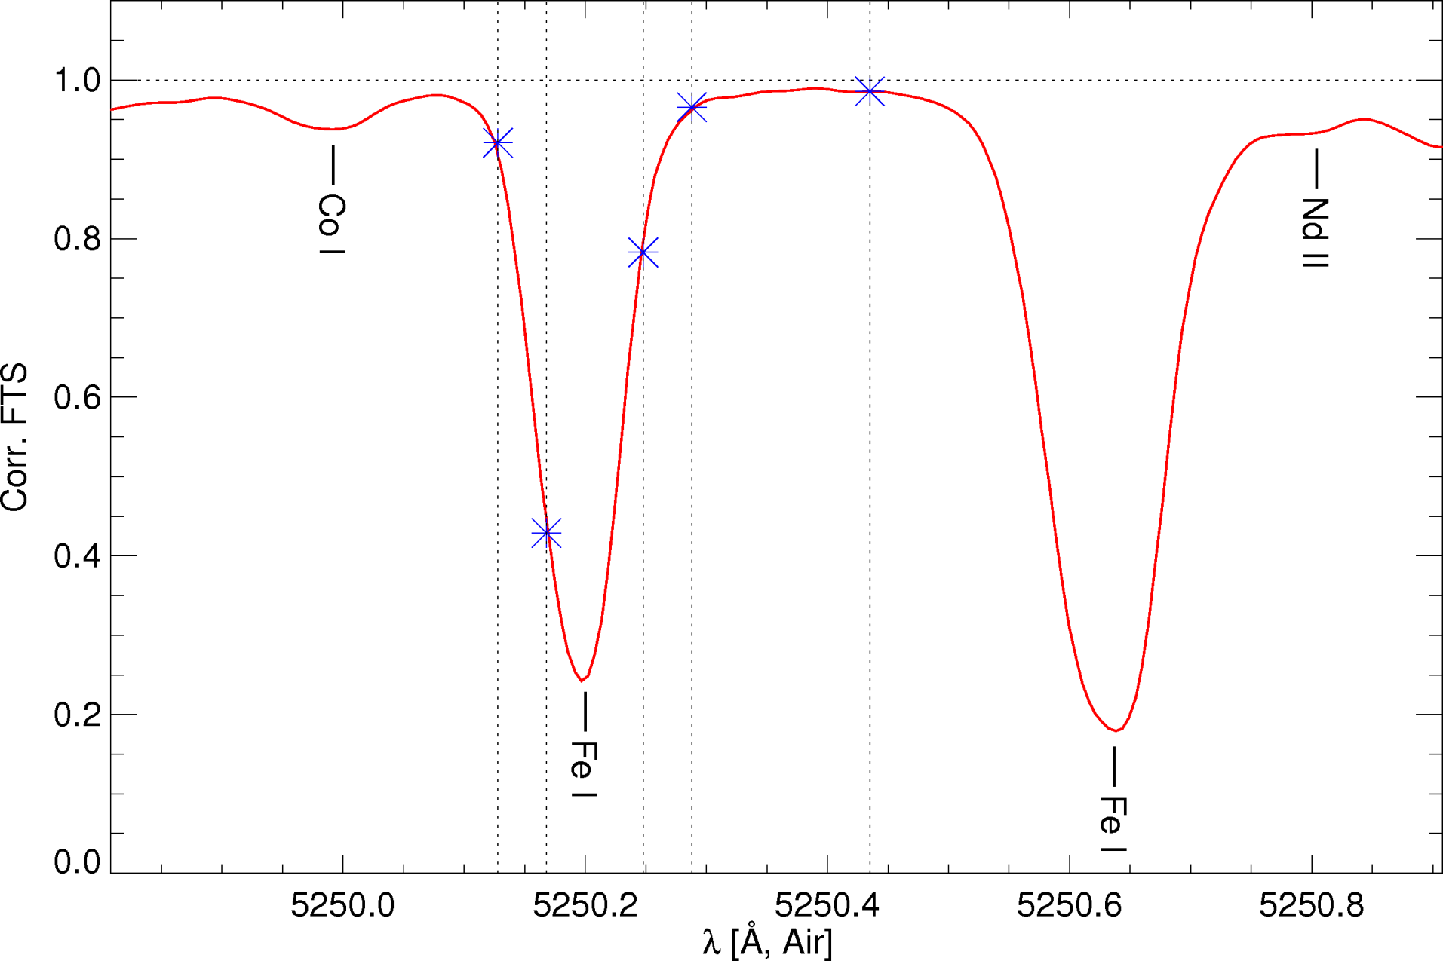
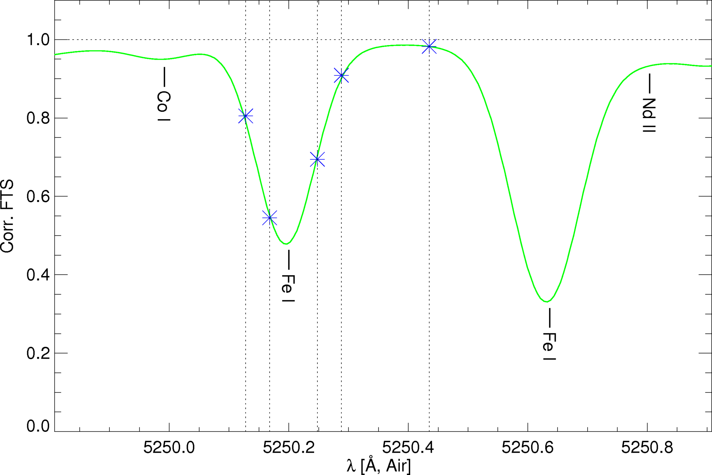
The relevant environment
FTS
FTS * 85mA Gauss

Slide 6
The relevant environment
FTS * 85mA Gauss

Slide 7
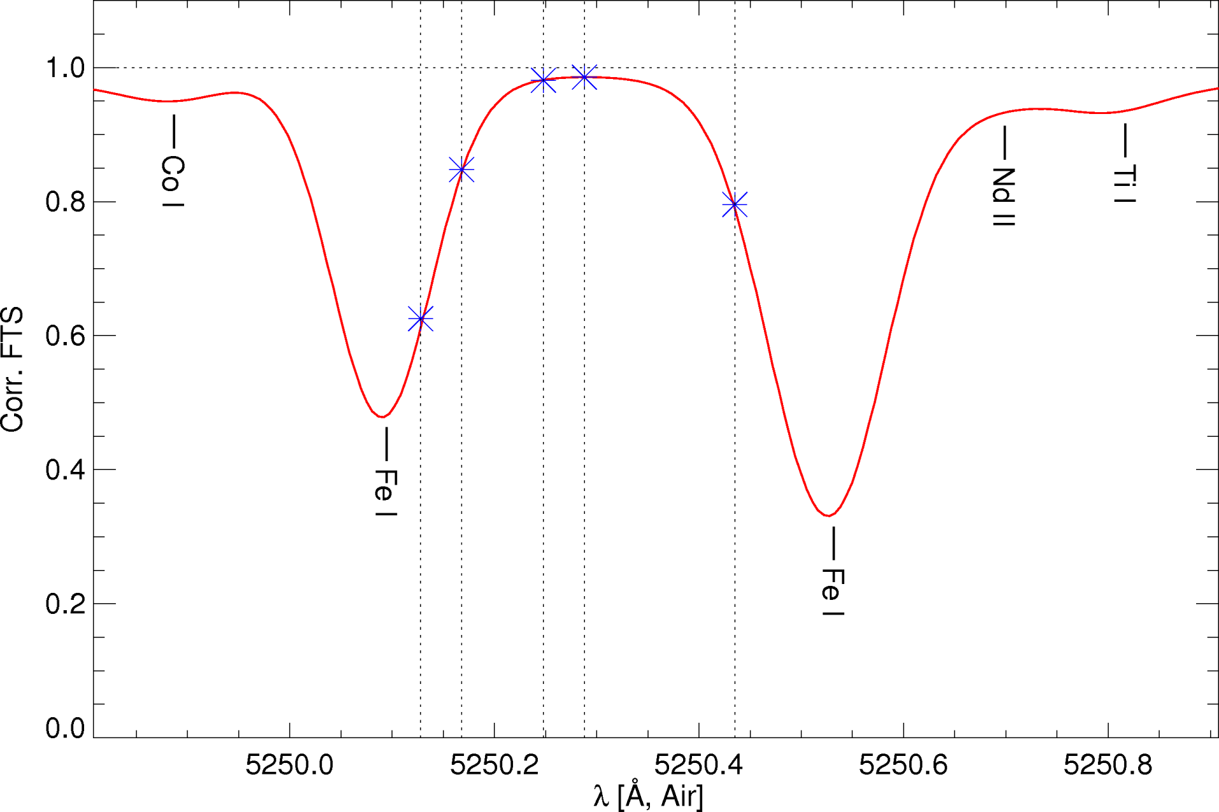
The relevant environment
FTS * 85mA Gauss, 6 km/s upflow

Slide 8
Milne-Eddington Inversion
8 free parameters:
B-strength, -azimuth, -inclination
LOS-velocity
Doppler-broadening
Damping parameter
source function gradient
source function at τ=0
85 mÅ FWHM Gaussian convolution
→ IMaX filter
Inversion Codes:
VFISV (Borrero), HeLiX+ (Lagg), …
Test Data Set:
2009-06-09, 163-208

Slide 9
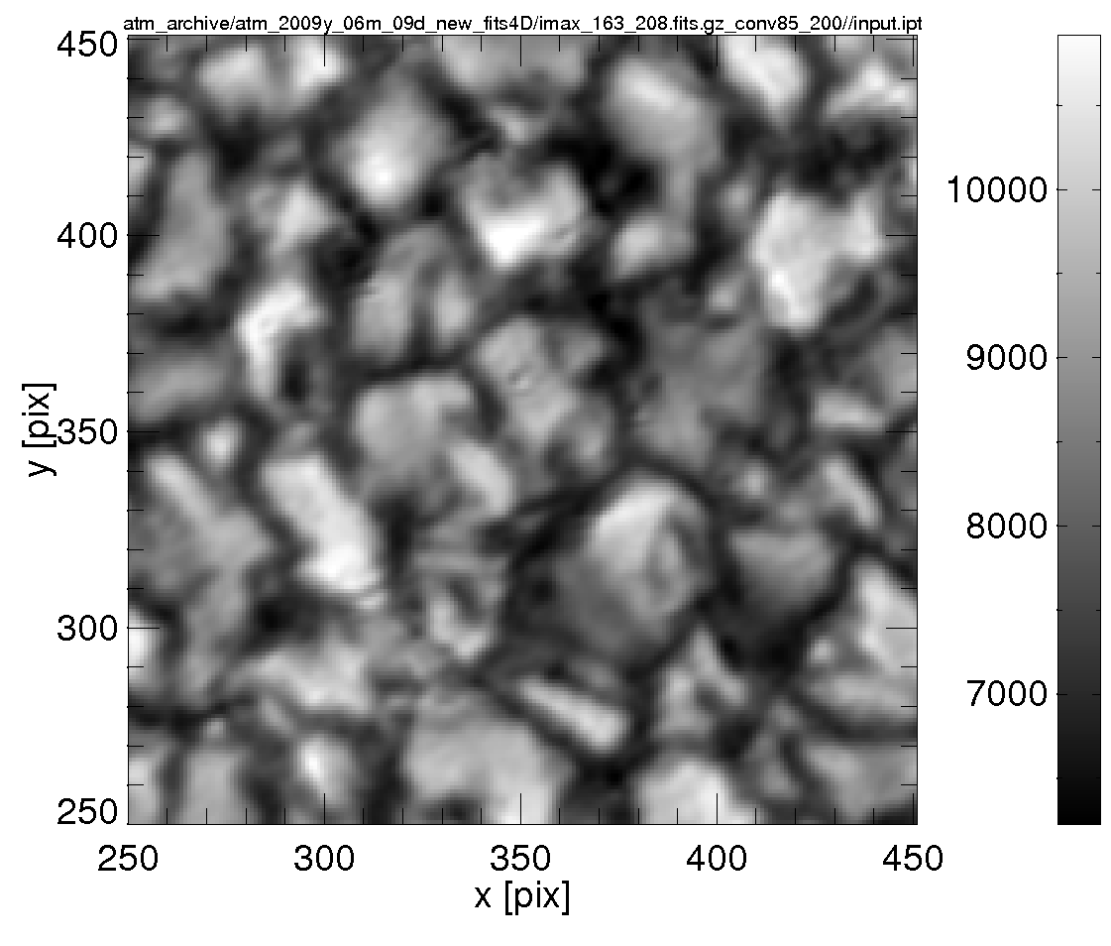
VFISV: Continuum level
2009-06-09, 163-208

Slide 10
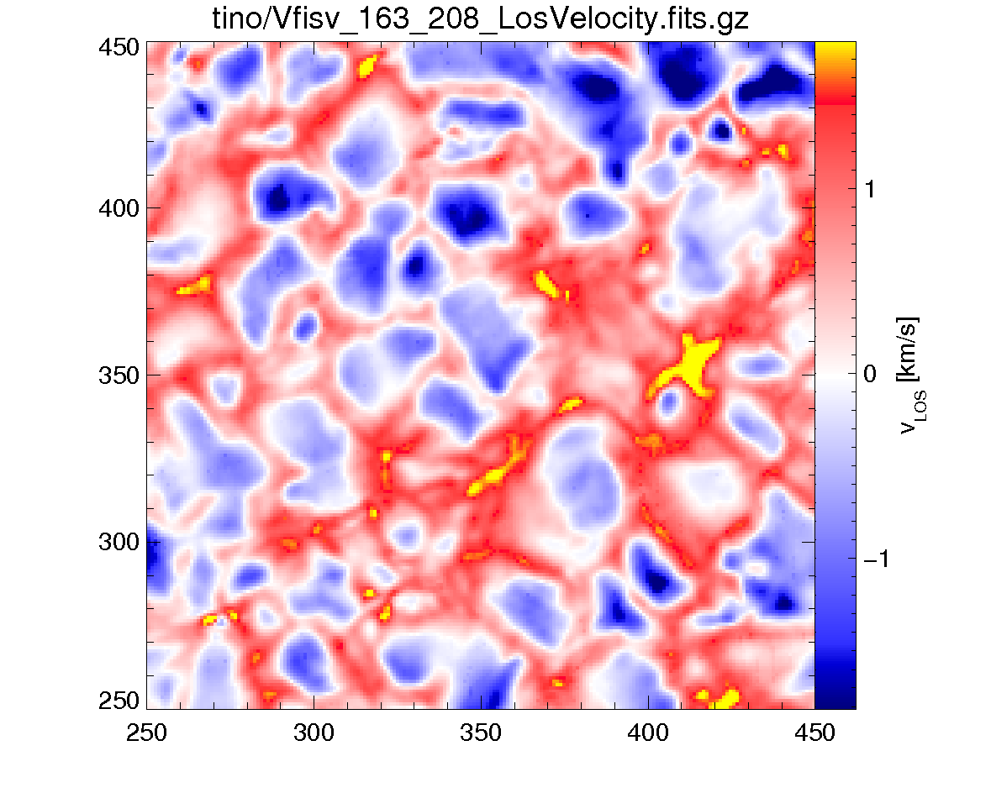
VFISV: LOS-Velocity
2009-06-09, 163-208

Slide 11
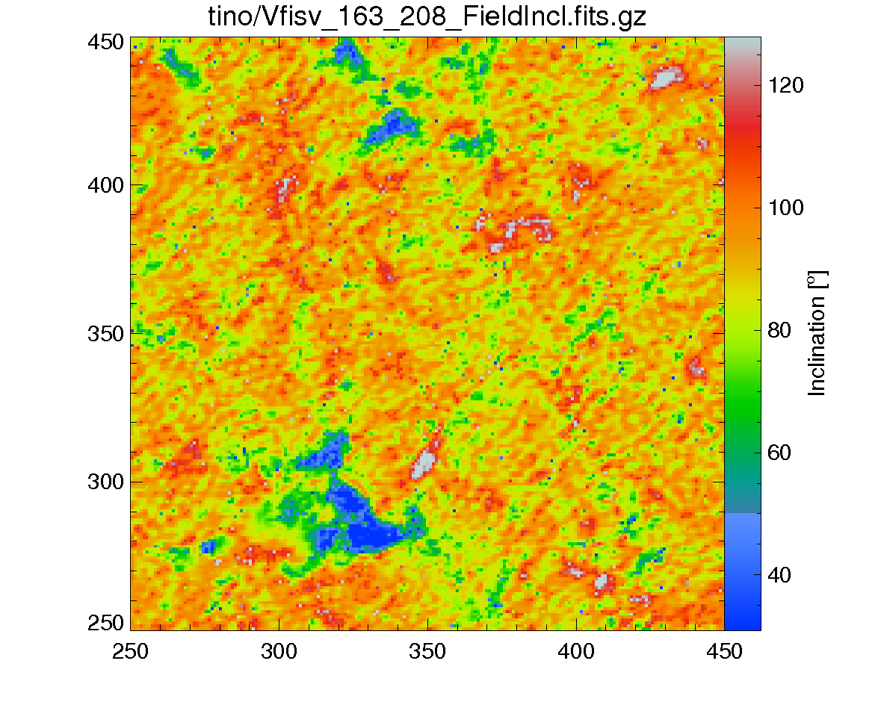
VFISV: Inclination
2009-06-09, 163-208

Slide 12
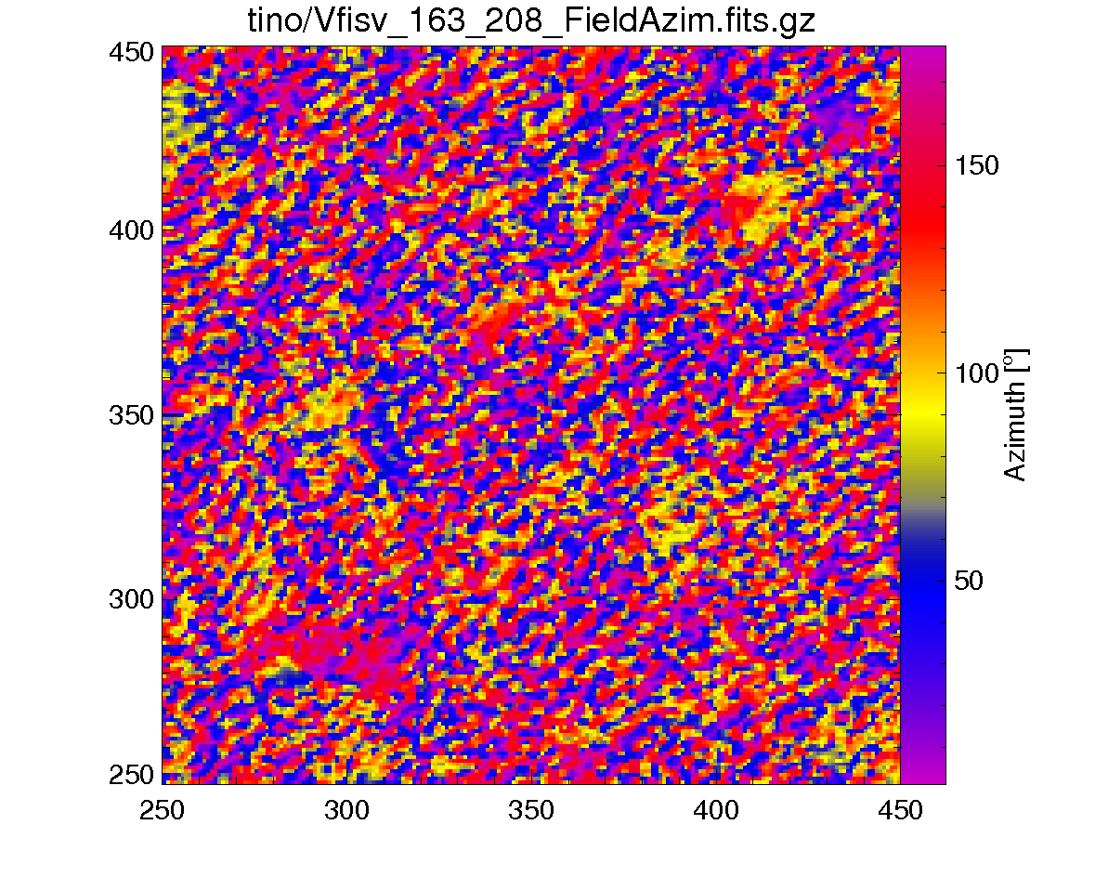
VFISV: Azimuth
2009-06-09, 163-208

Slide 13
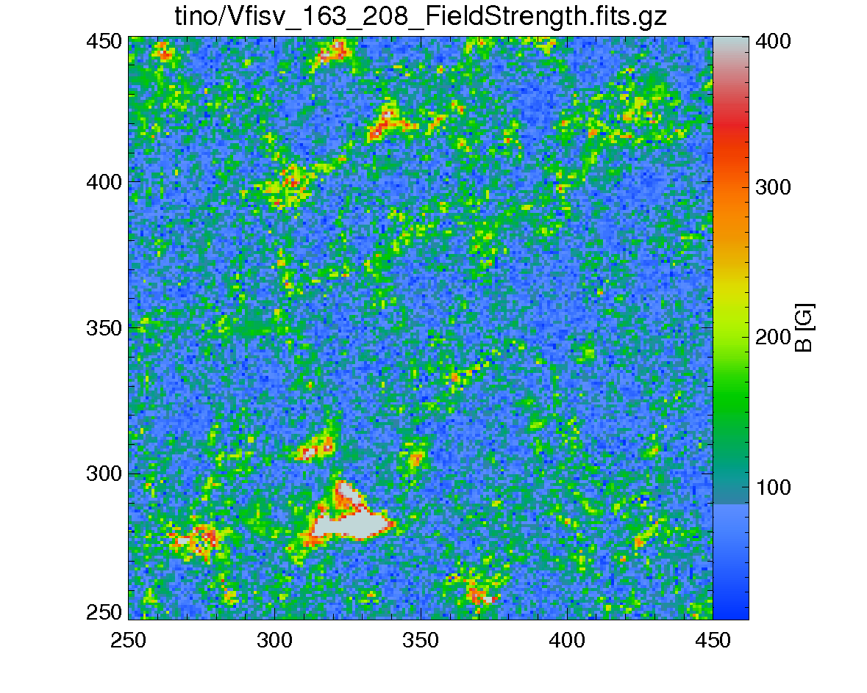
VFISV: B (FF=1)
2009-06-09, 163-208

Slide 14
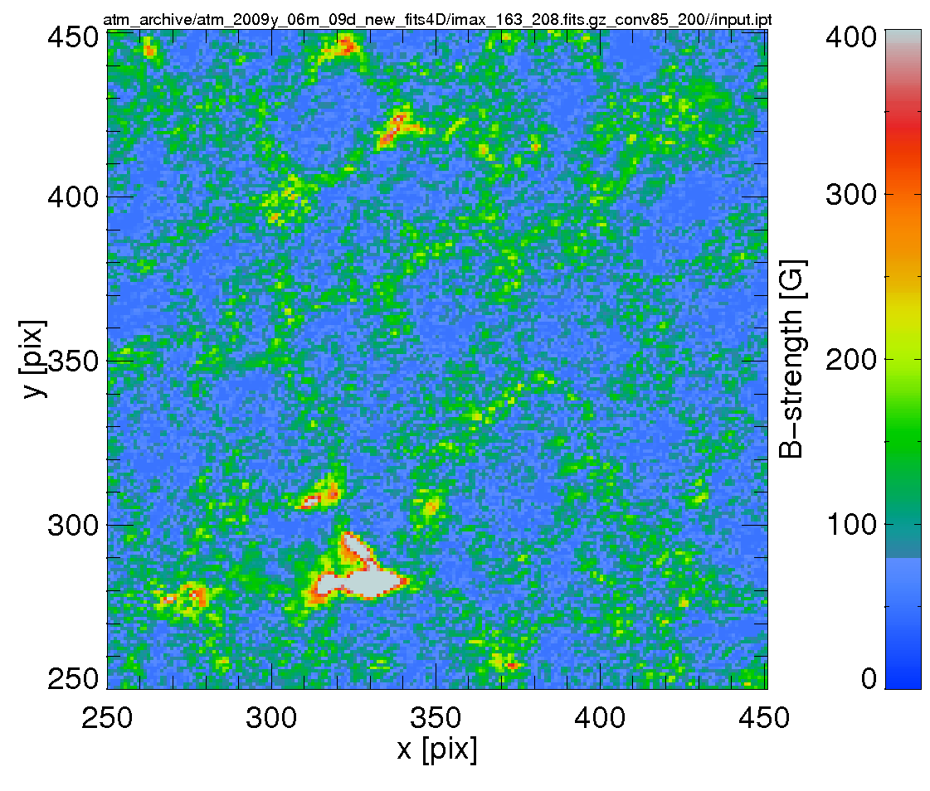
HeLIx+: B(FF=1)
2009-06-09, 163-208

Slide 15
local straylight correction
weight
1 additional free parameter (FF)
2009-06-09, 163-208

Slide 16
HeLIx+: B(FF=1), no local stray light
2009-06-09, 163-208

Slide 17
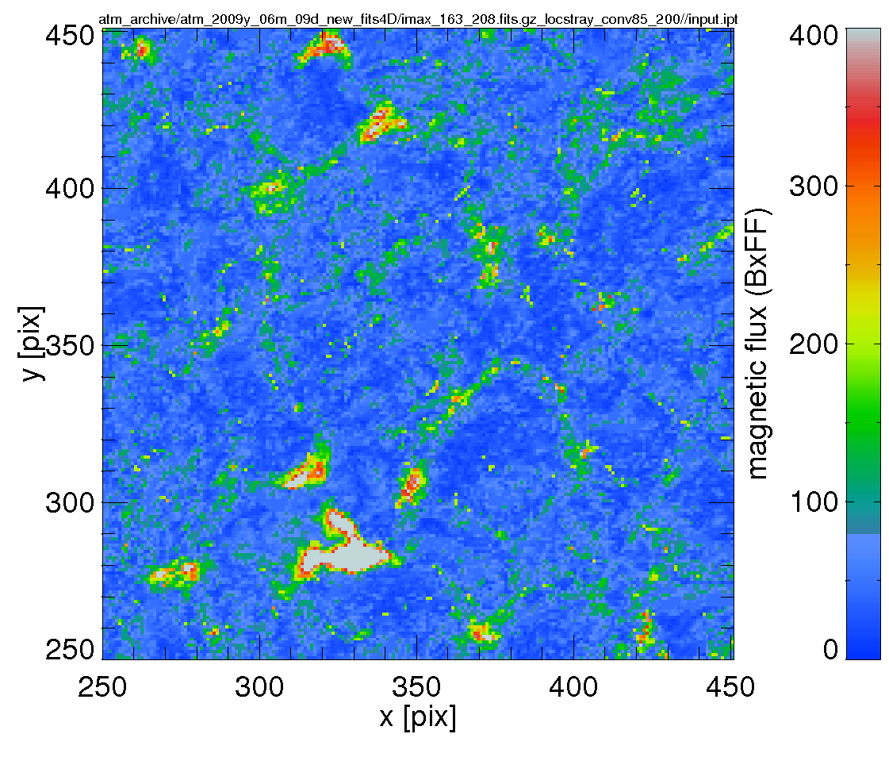
HeLIx+: Add local straylight, BxFF
2009-06-09, 163-208

Slide 18
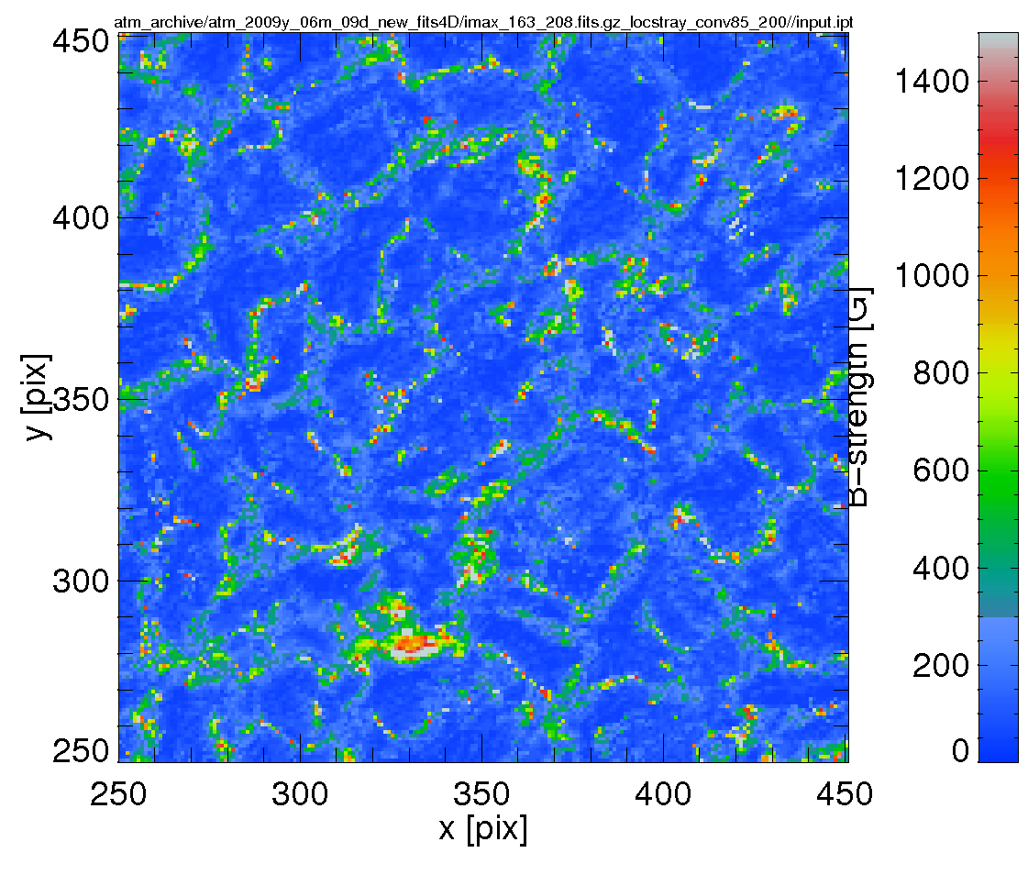
HeLIx+: local straylight, B strength
2009-06-09, 163-208

Slide 19
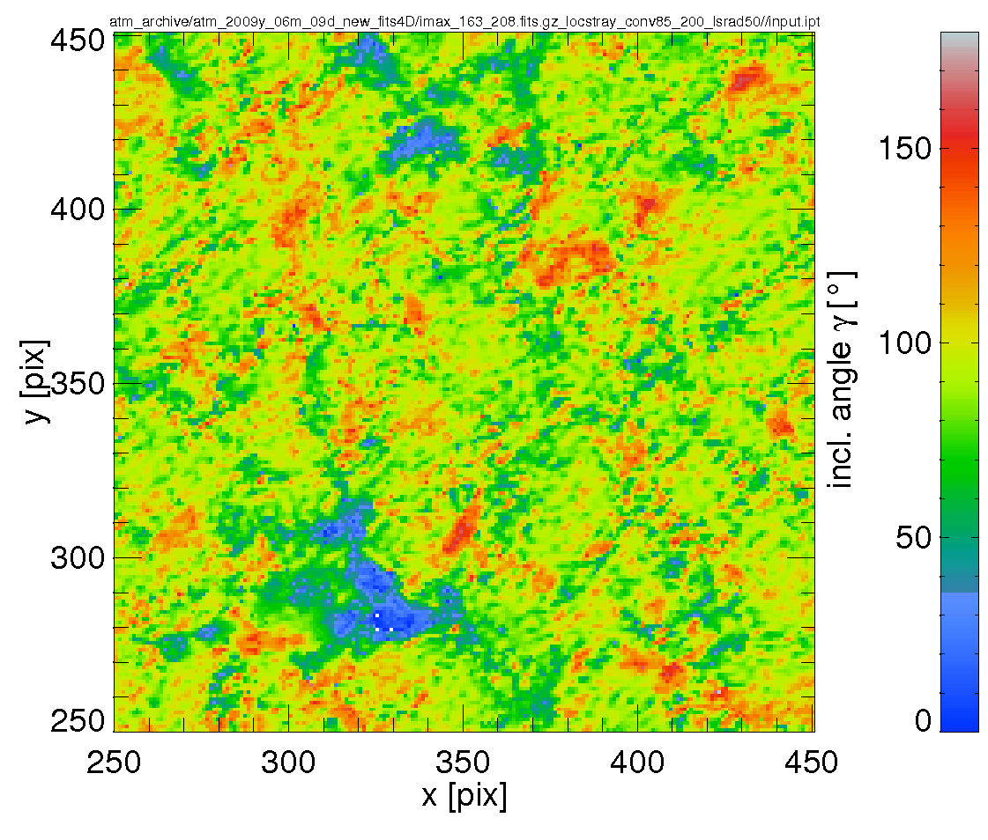
HeLIx+: local straylight, B inclination
2009-06-09, 163-208

Slide 20
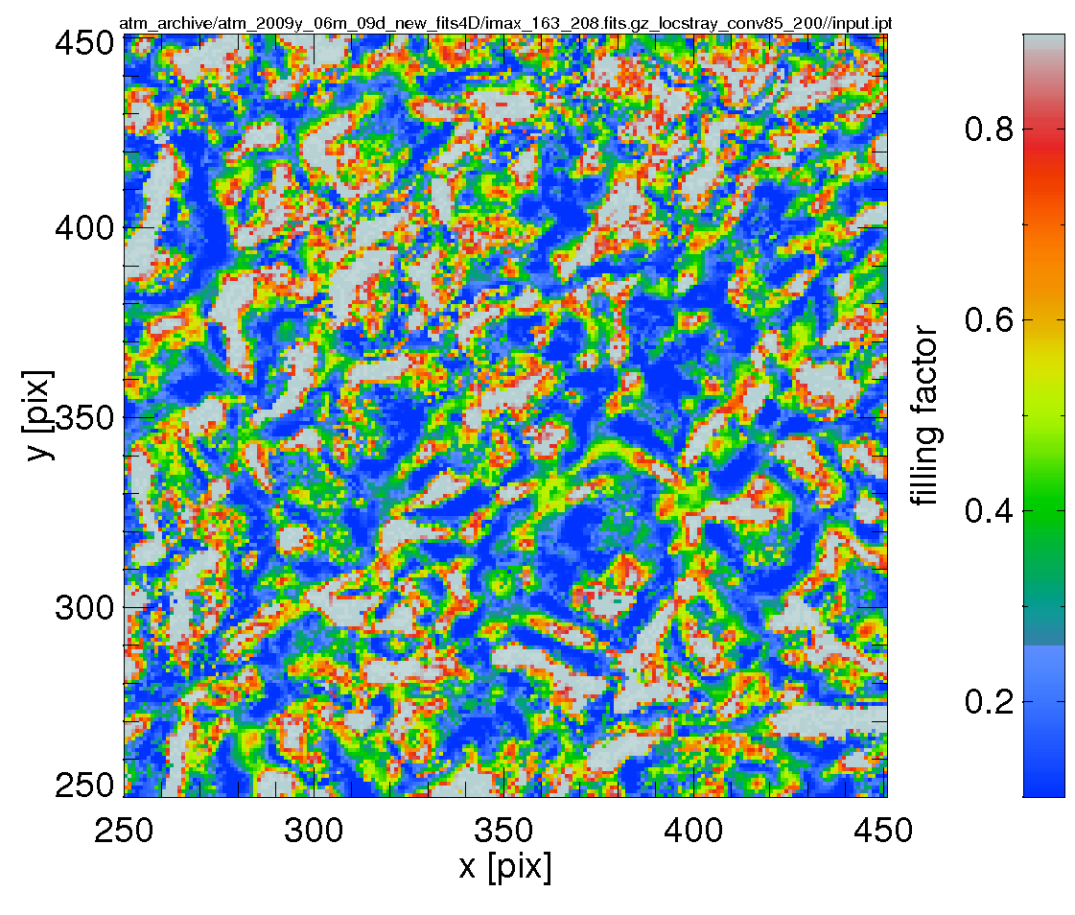
HeLIx+: local straylight, magn. FF
2009-06-09, 163-208

Slide 21
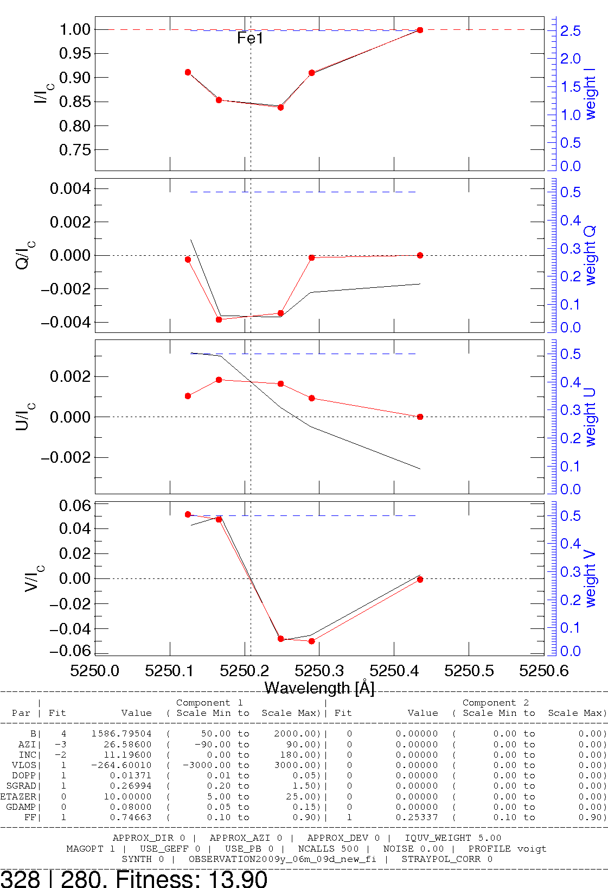
HeLIx+: local straylight, B strength
high B (1.5 kG)
B vert. (11°)
high FF (0.75)
2009-06-09, 163-208

Slide 22
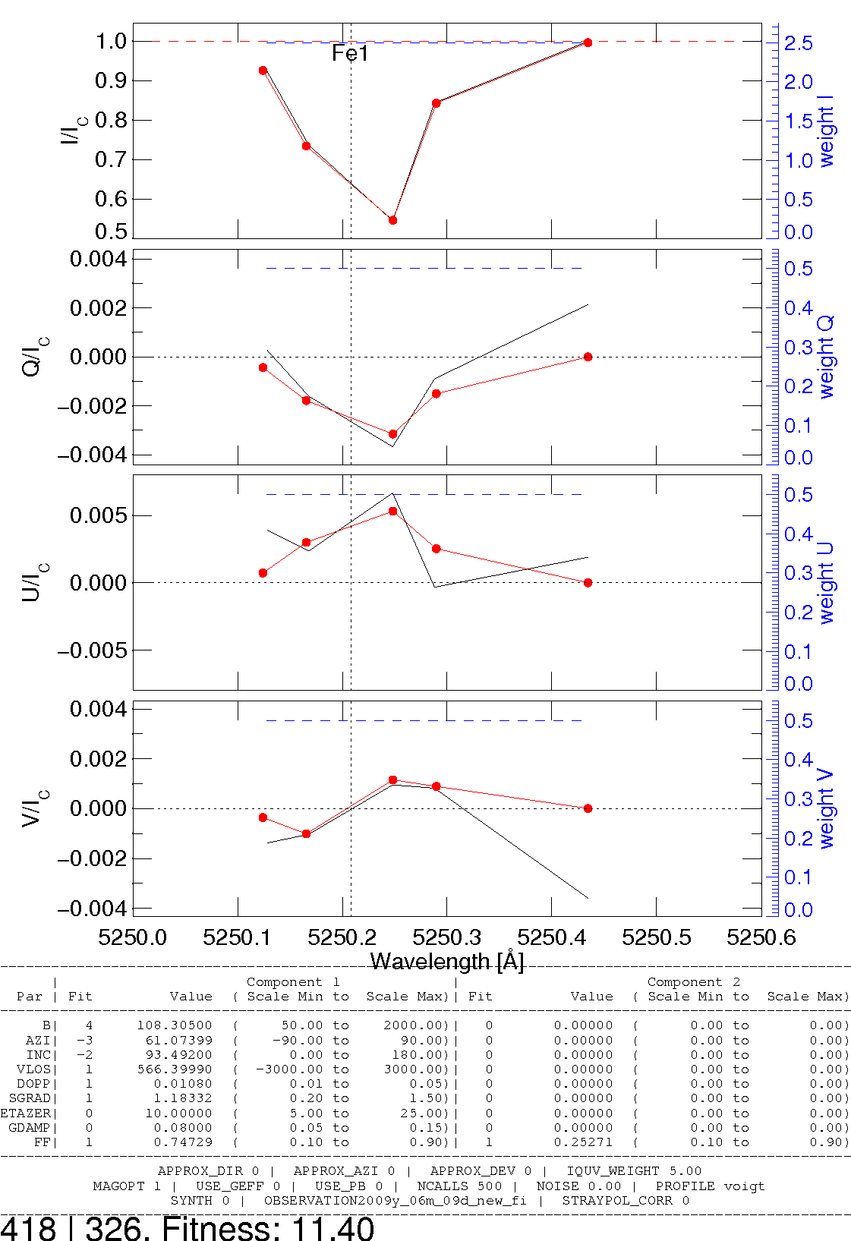
HeLIx+: local straylight, B strength
low B (110 G)
B horiz (93°)
high FF (0.75)
2009-06-09, 163-208

Slide 23
HeLIx+: local straylight, B strength
2009-06-09, 163-208

Slide 24
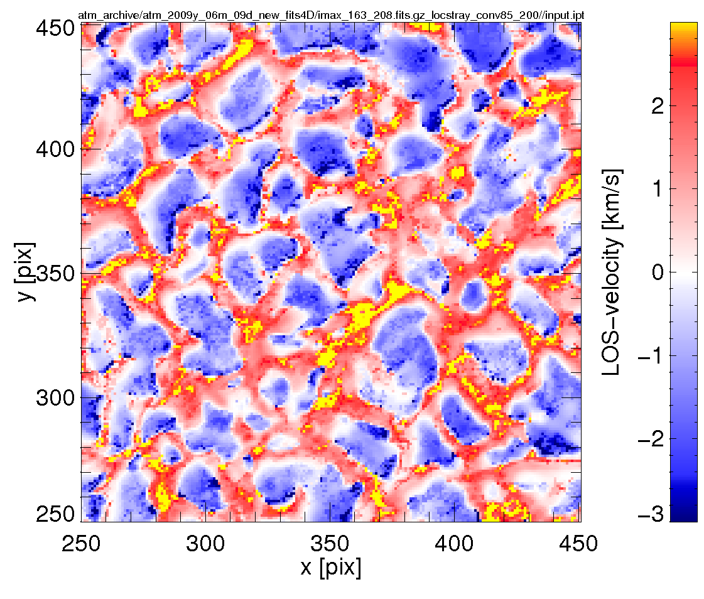
HeLIx⁺: LOS-velocity, magn. comp.
2009-06-09, 163-208

Slide 25
Inversions: ME vs. numerical RTE solver
8 free parameters:
  B-strength
  B-azimuth
  B-inclination
  LOS-velocity
  Doppler-broad.
  Damping parameter
  source func grad
  source func at τ=0
fast & simple
7 free parameters:
  B-strength
  B-azimuth
  B-inclination
  LOS-velocity
  Micro-Turbulence
  Macro-Turbulence
  Temperature at τ=0
‚physical‘ param.
multi-line
complex atmosphere
eg. gradients
slow

Slide 26
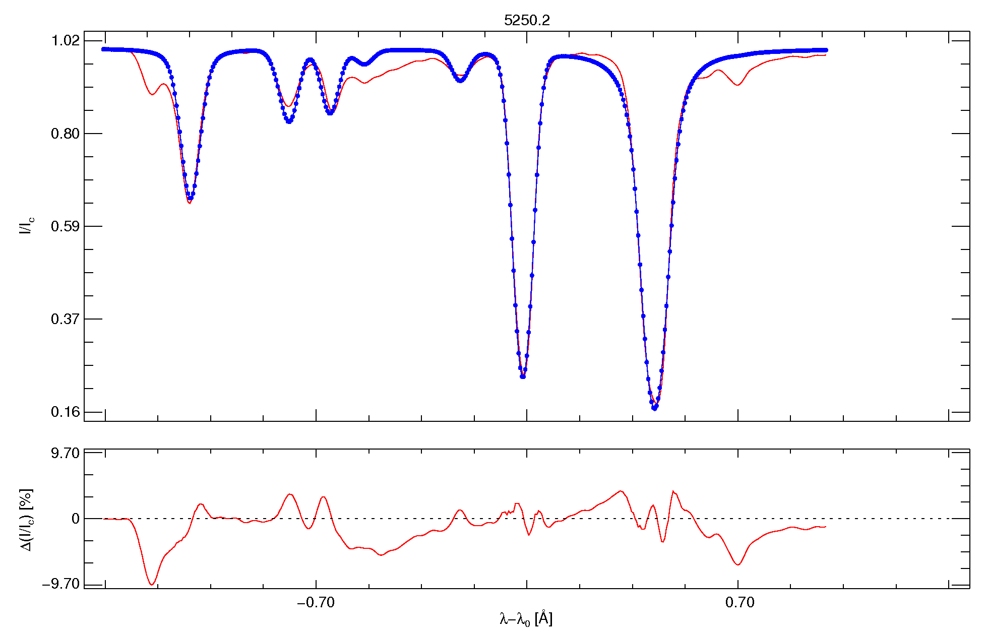
SPINOR Fit to FTS
can easily handle ±6km/s

Slide 27
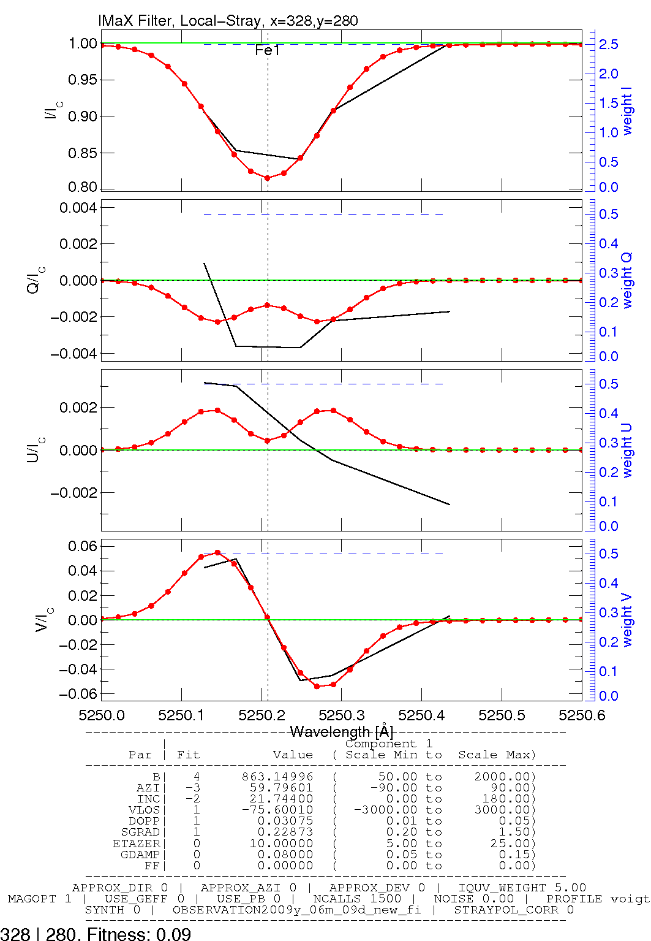
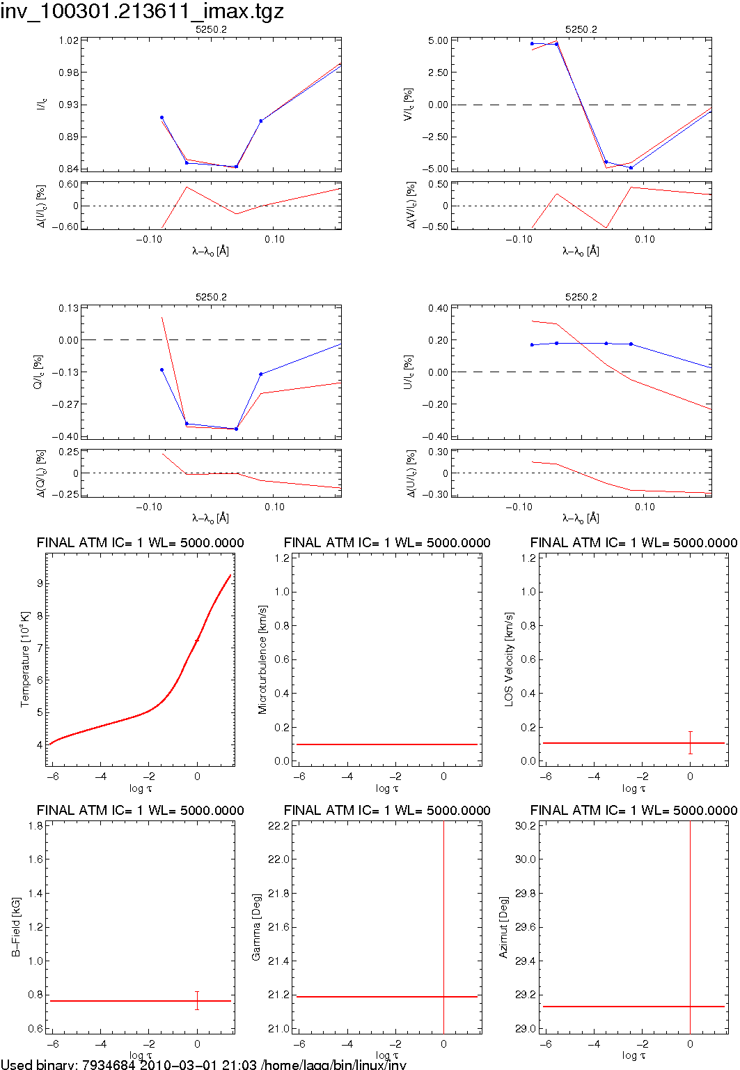
Milne Eddington Num. RTE Solver

Slide 28
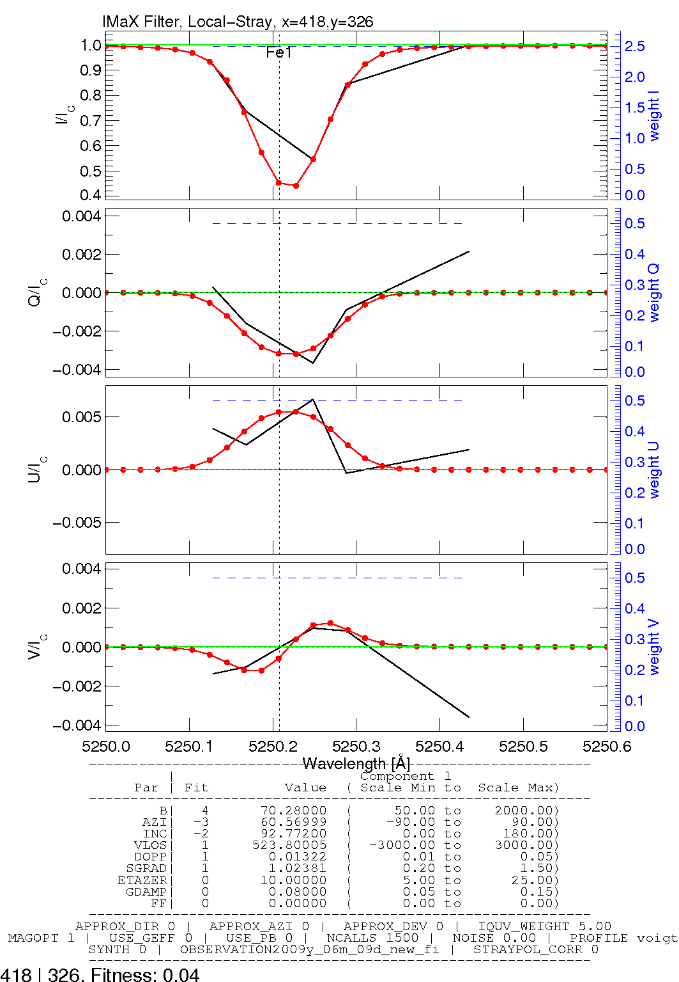
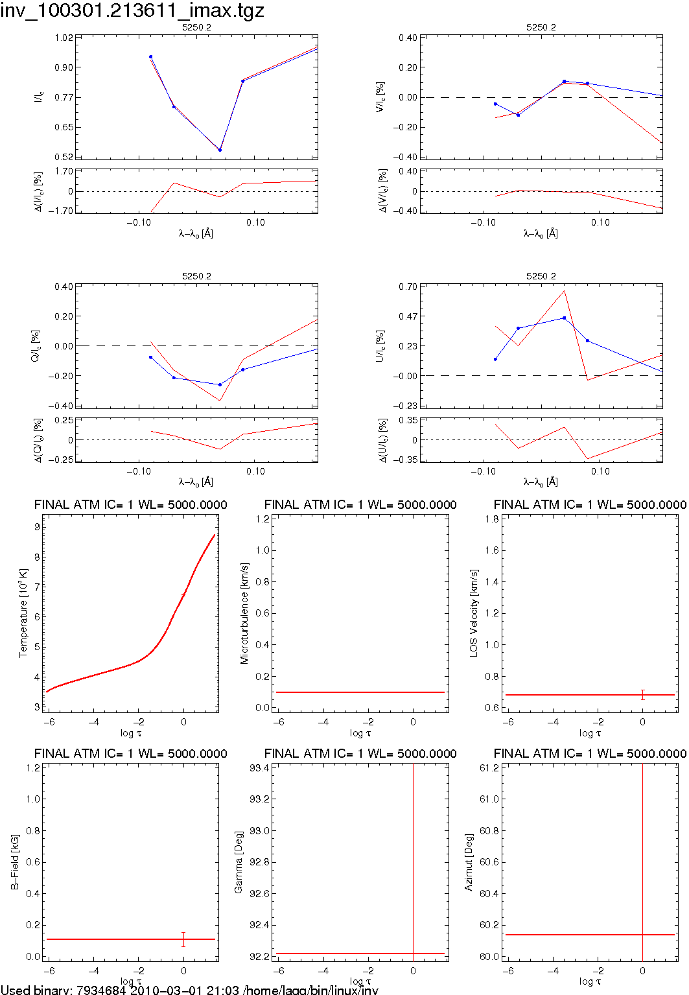
Milne Eddington Num. RTE Solver

Slide 29
Summary & Outlook
Good agreement:
VFISV ↔ HeLIx⁺ ↔ SPINOR
magnetograph formula?
Local Straylight correction is feasible
Numerical RTE Solver (SPINOR) promising
Determine correct parameters for local straylight correction (limb data)
implement local-straylight to SPINOR
compare VFISV ↔ SPINOR maps
high LOS velocities: test line blending
strong field regions: test V_{LOS}, B-gradient

