Slide 1

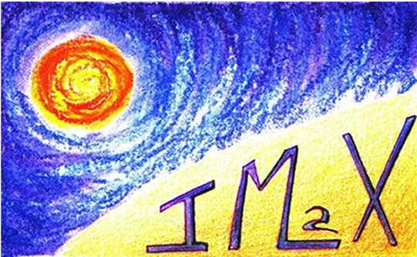
Fully resolved quiet Sun magnetic fluxtubes
Andreas Lagg, MPS
& IMaX and Sunrise team
2nd Sunrise Science Meeting, May 4-5 2010, Freiburg
TexPoint fonts used in EMF.
Read the TexPoint manual before you delete this box.: AA

Slide 2
kG fields in plage & network
Unresolved: indirect techniques required
Stenflo (1973): line ratio technique
  Fe 5250 line weakened by 50% in the network
  field strength up to 2kG
  size 100-300 km

Slide 3
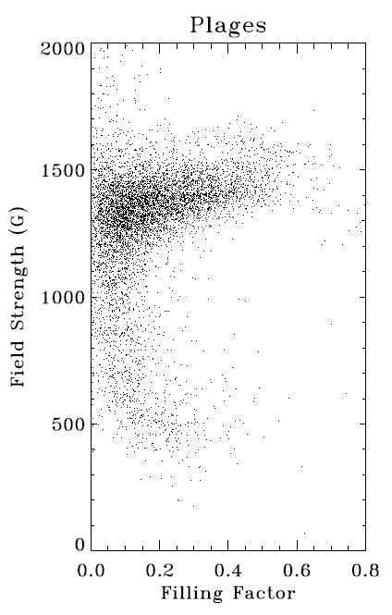
kG fields in plage & network
Martinez-Pillet et al. (1997): inversions
  AR plage: 1.4kG
  vertical fields
  require filling factor

Slide 4
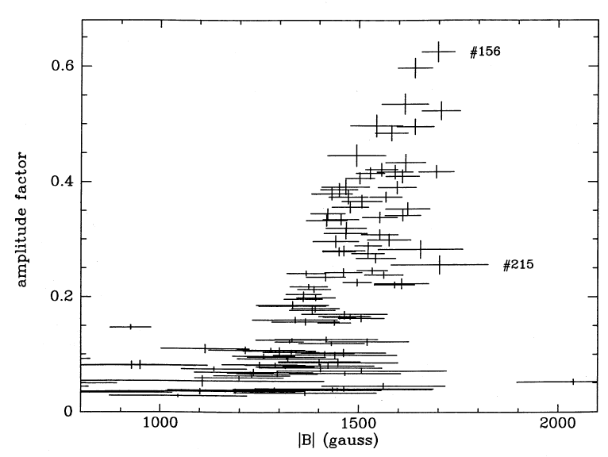
kG fields in plage & network
Rüedi et al. (1992), Rabin (1992)
  complete splitting of Fe 15650 Å lines

Slide 5
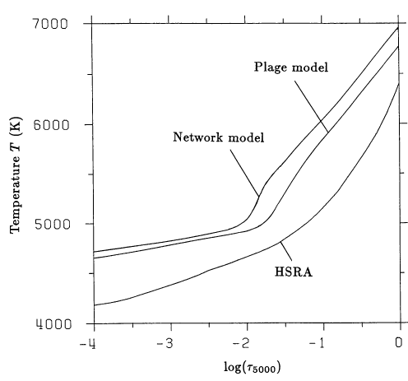
Temperatures in plage & network
Solanki (1986), Solanki & Brigljevic (1992)
  temperature of continuum forming layers from line ratios of CI and Fe II (Stokes I and V)
  magnetic elements have on average brighter continuum than quiet Sun when FF is small
  derived from FF 5-8%
1000° hotter than avg. quiet Sun in line-forming layer

Slide 6
Motivation
I profile extremely weak (7%)
→ high temperature
large Stokes V (5%)
→ ME-Inv.: ≥ 1 kG
Can we finally resolve the quiet Sun magnetic structures?

Slide 7
Tool: Inversions (non-ME)
numerical solution of RTE (SPINOR)
free parameters:
B, INC, AZI, VLOS – height independent
VMIC (fix to 0.8km/s)
VMAC (avg QS: 2km/s)
T0, TGRAD
normalization to HSRA (J.M. Borrero)
convolve with 85mÅ Gaussian

Slide 8
HSRA cont.
=1
(=avg. quiet Sun)
normalization of Stokes profiles to average QS profile:
avg QS
cont-level := 1
avg QS = HSRASP
change HSRASP with linear gradient
(T0, TGRAD)
network patch
center of granule
intergran. lane

Slide 9
normalization of Stokes profiles to average QS profile:
avg QS cont-level := 1
avg QS = HSRASP
change HSRASP with linear gradient
(T0, TGRAD)
HSRA cont. :=1
(=avg. quiet Sun)

Slide 10
Cont. normalization: HSRA

Slide 12
network patch
center of granule
intergran. lane
TexPoint fonts used in EMF.
Read the TexPoint manual before you delete this box.: AA

Slide 29
Summary & Conclusions
Small scale flux tubes in quiet Sun:
field strengths up to 1.3 kG
temperatues at line formation height 1000 K higher than quiet Sun
shallow temperature gradient
Without requiring a filling factor!
ubiquitous
correlation with bright points?
temporal evolution?

